Slide 1

GSD 200 ELECTRODE
Maintenance Assembly
Reference
IMPLANTER-Diffusion Department
Prepare by: SAMUEL 山姆爾 SaSPAREDOC.05

Slide 2
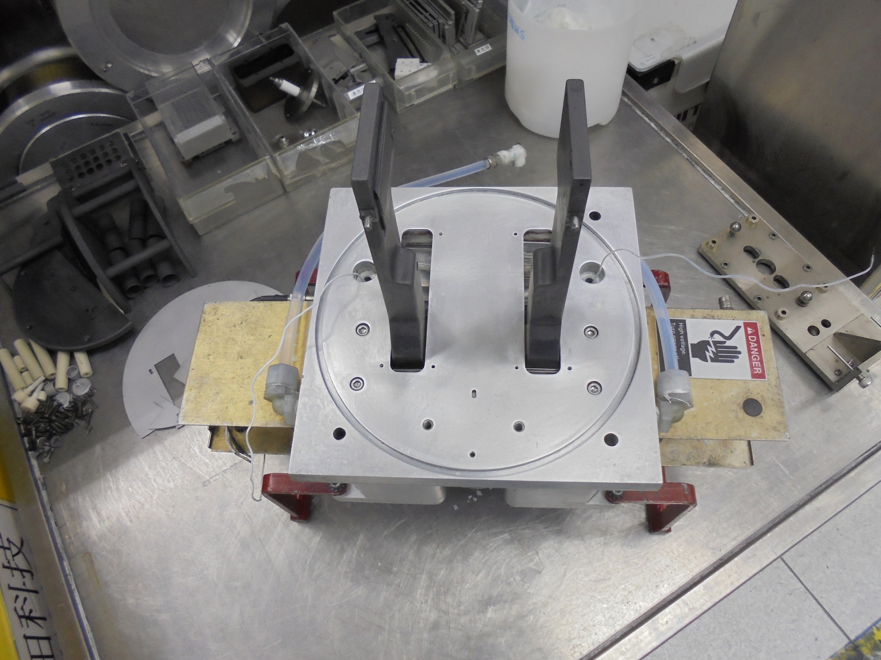
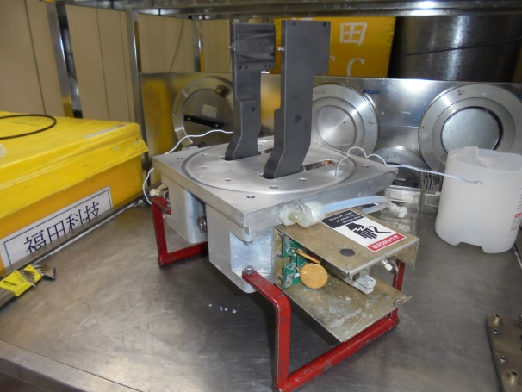
GSD-200 Electrode Body

Slide 3
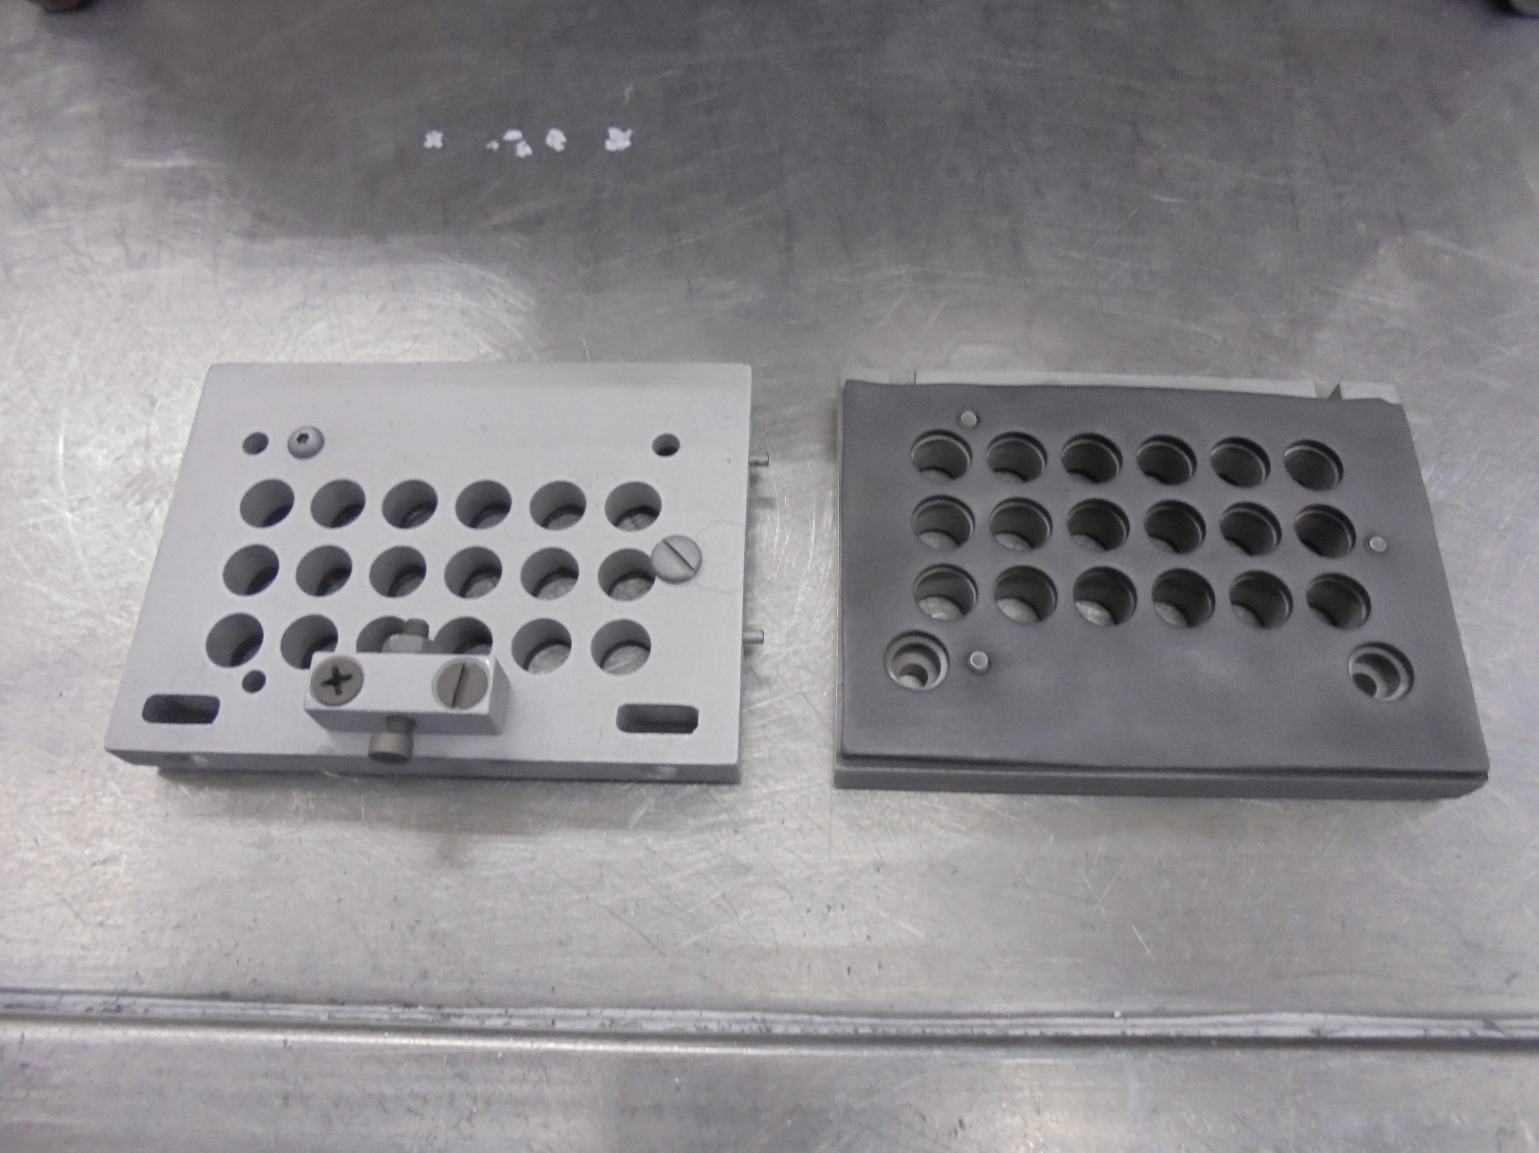
TOP MOUNTING PLATE
BOTTOM MOUNTING PLATE

Slide 4
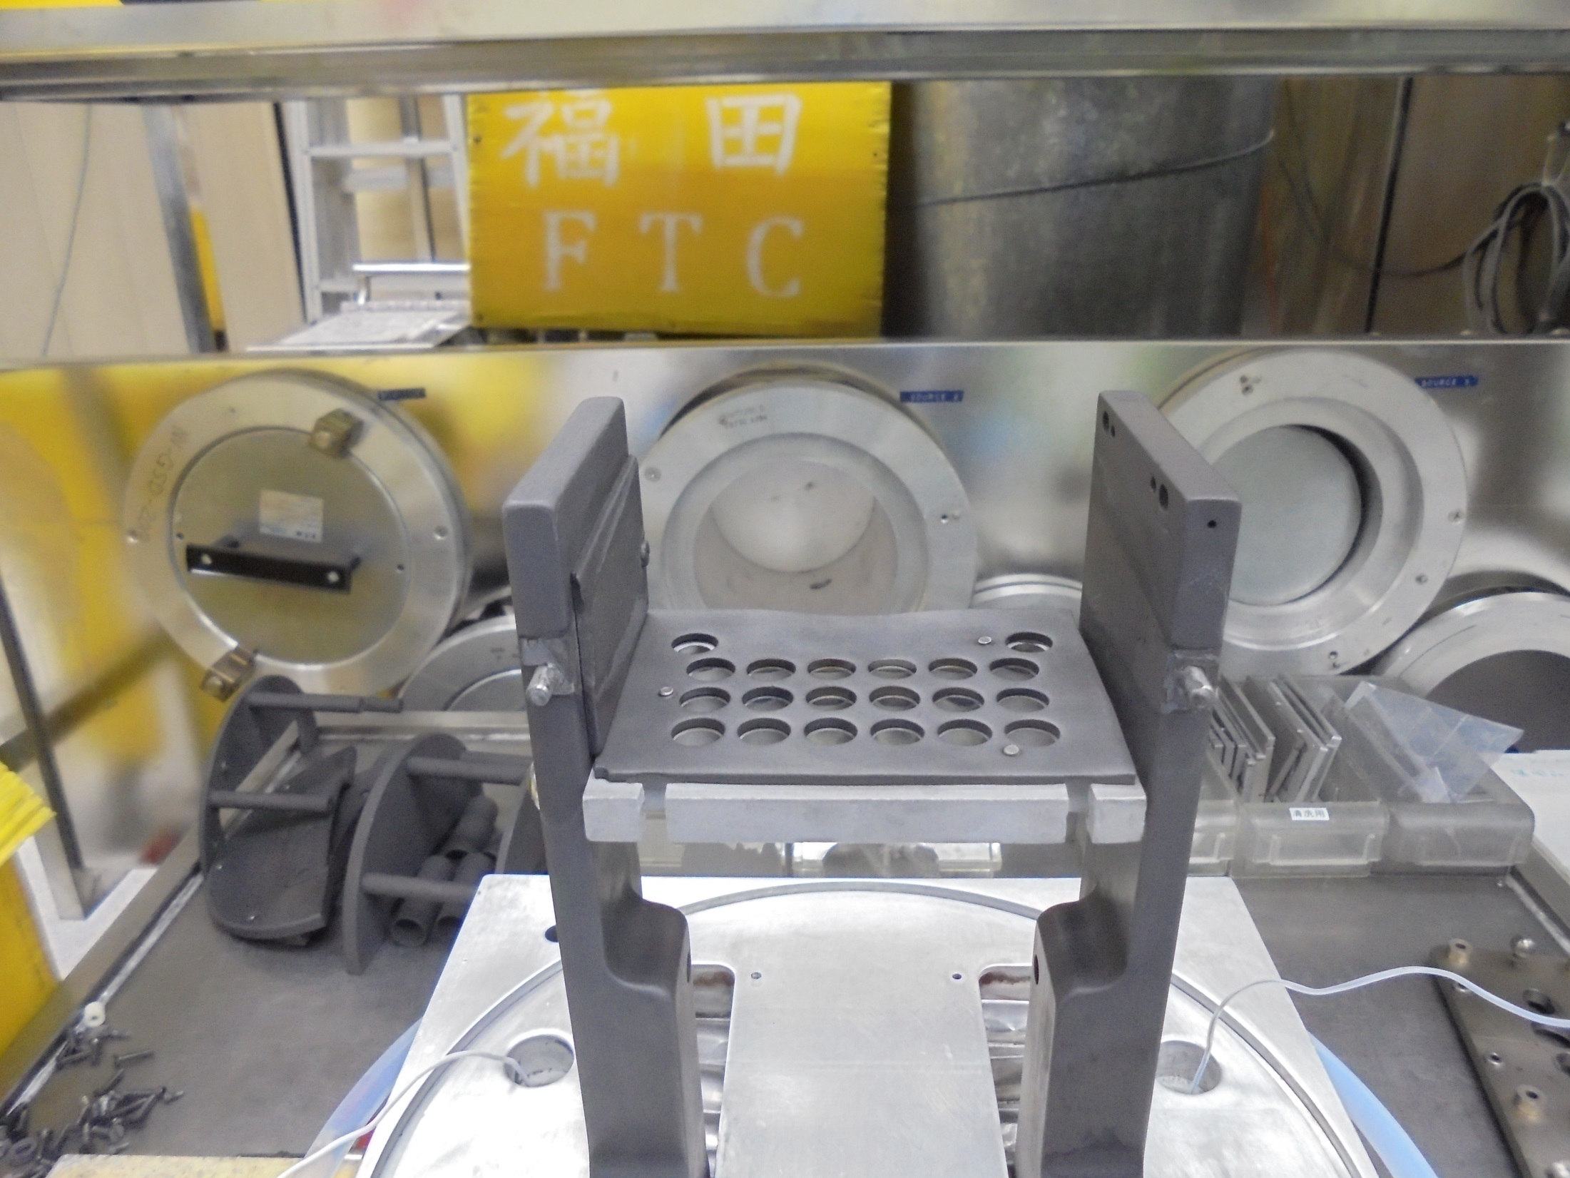
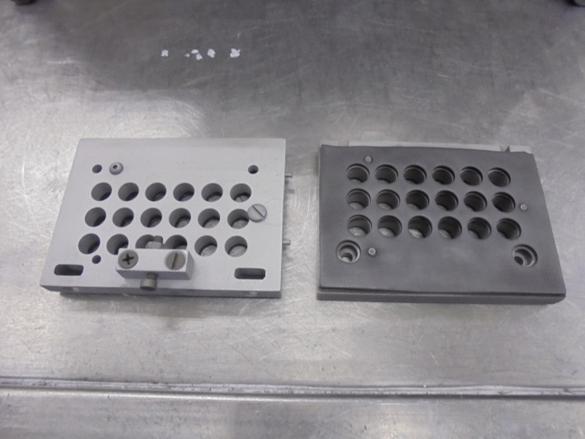
Install…
Here!

Slide 5
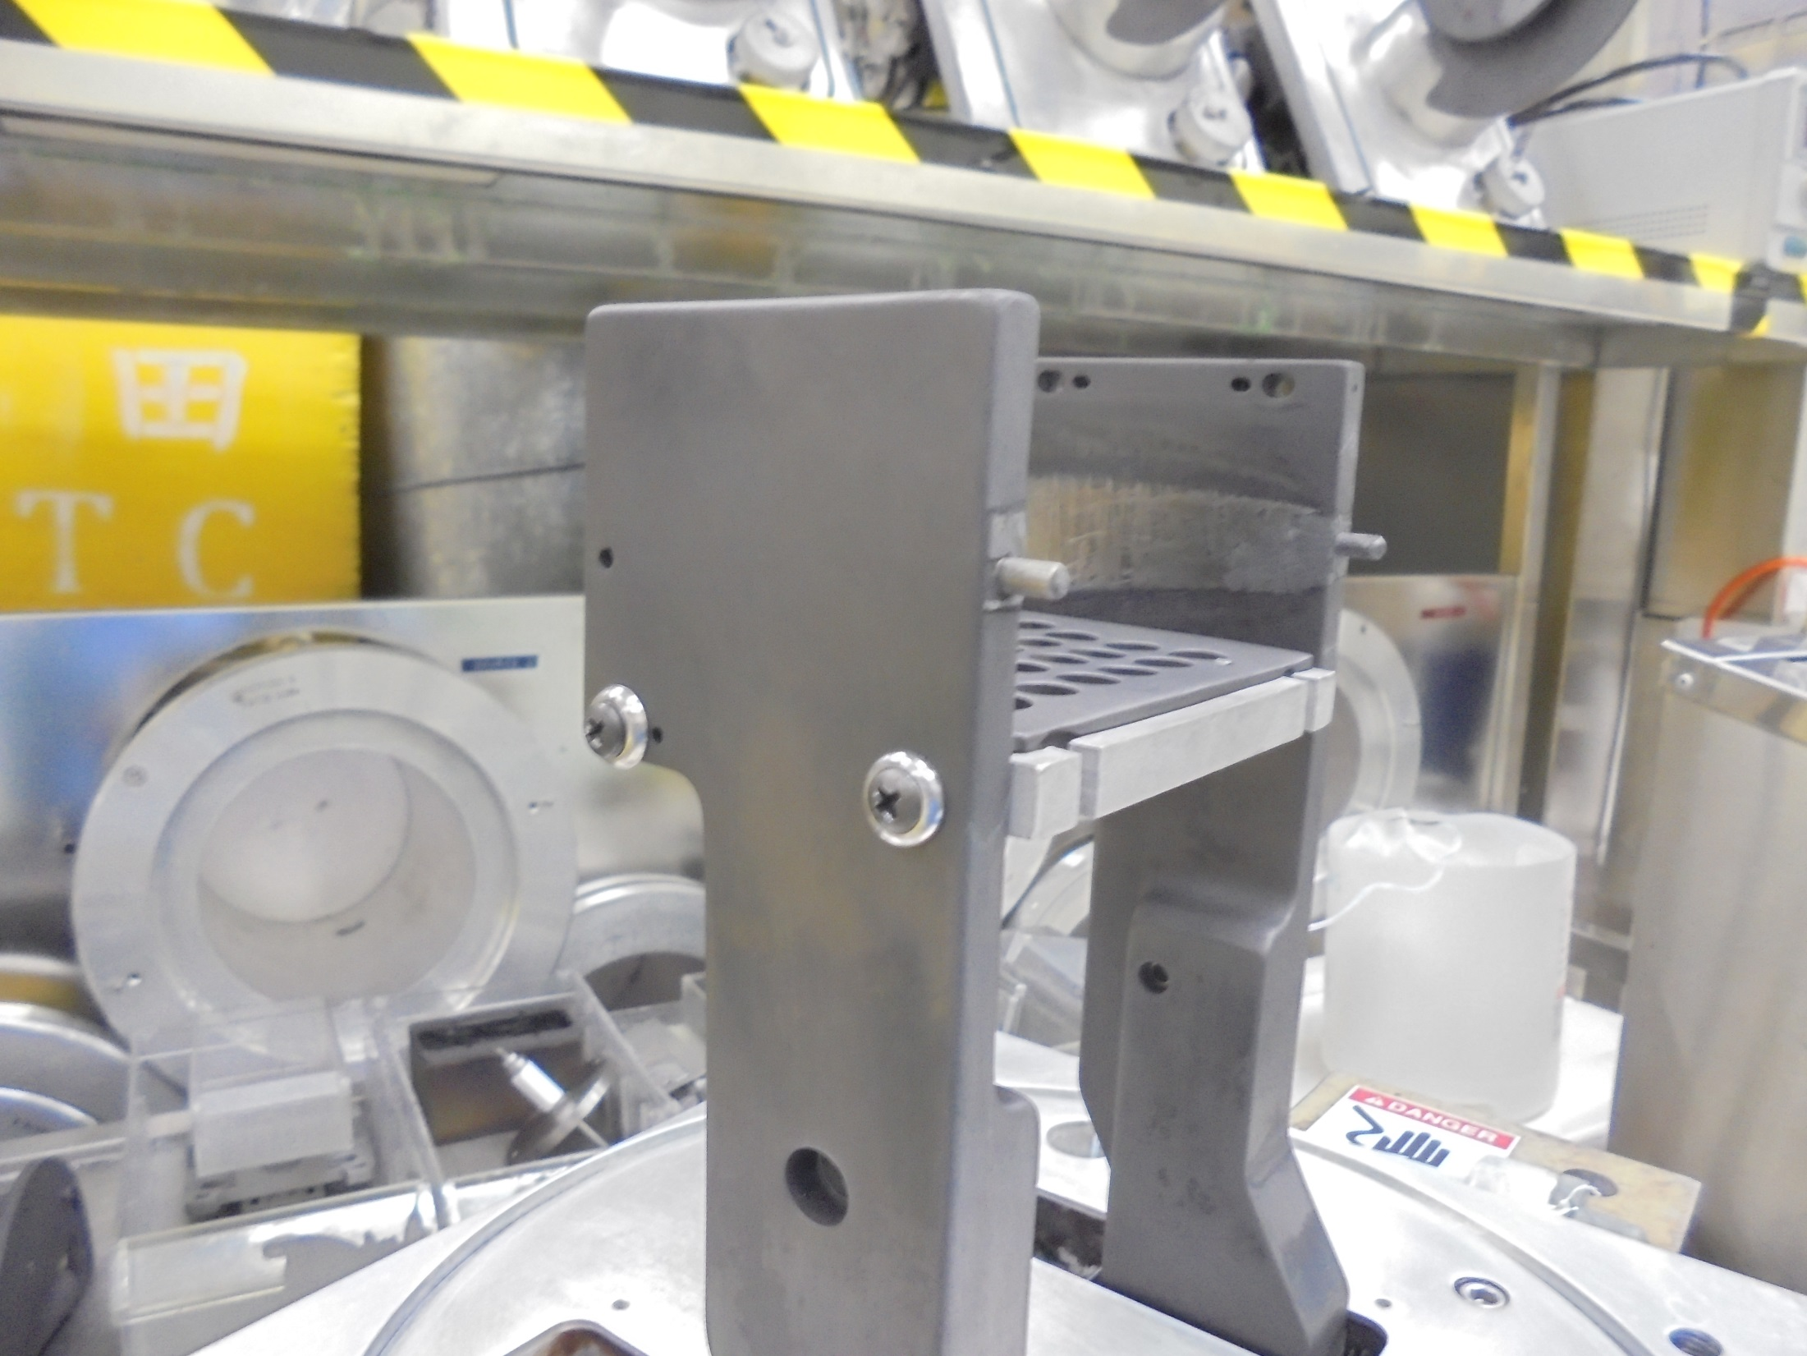
EXTRACTION ELECTRODE
ASSEMBLY ARM
Secure With Screws

Slide 6
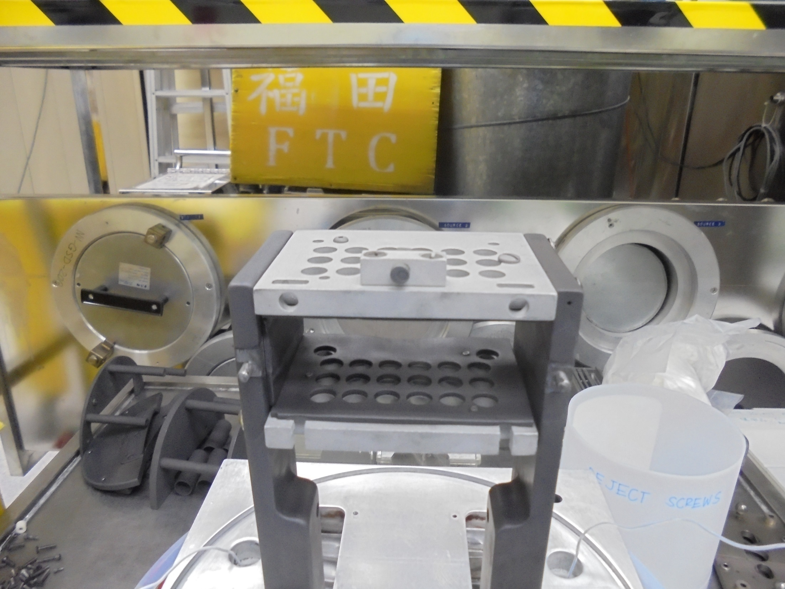
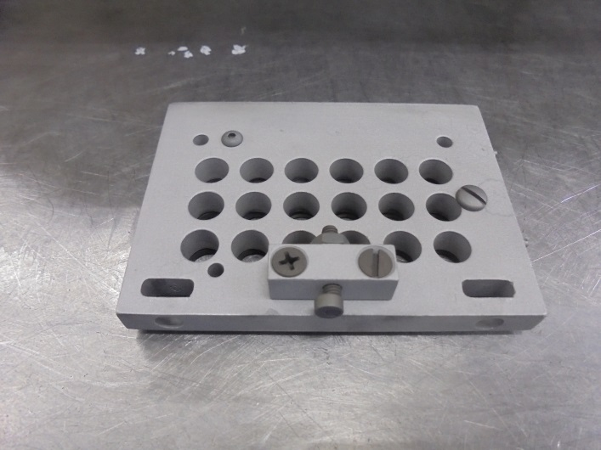
Secure Screws
Install…
Here!

Slide 7
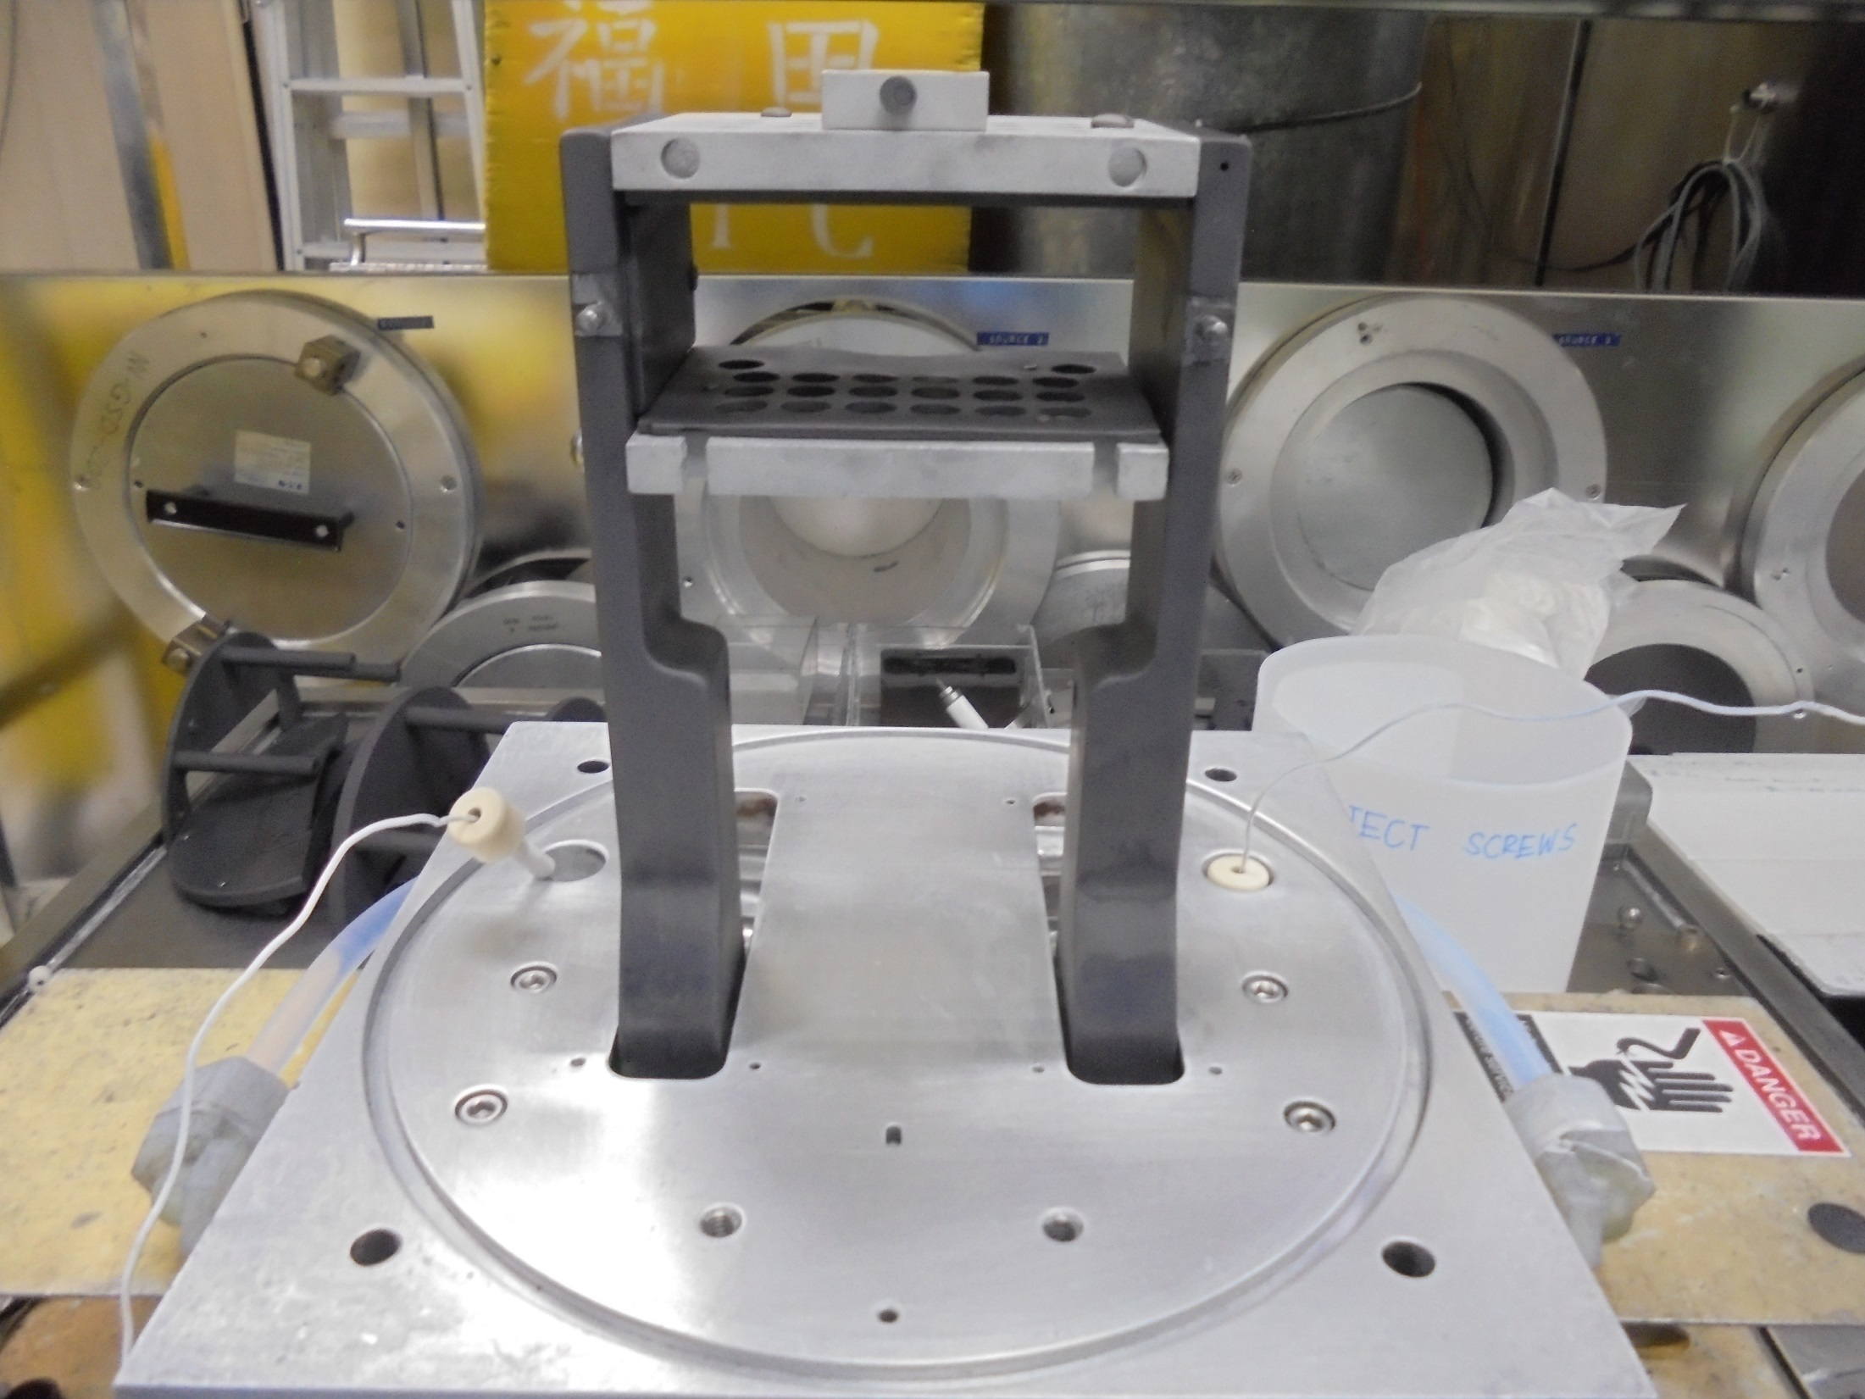
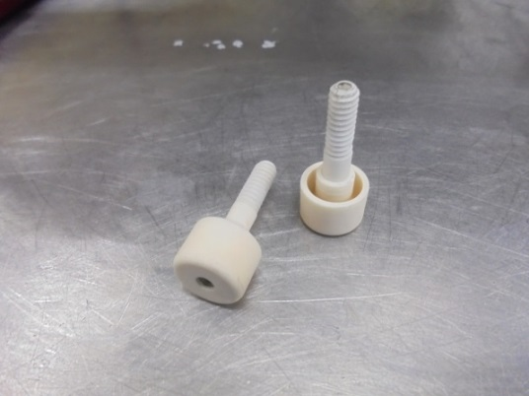
Electrode Insulator

Slide 8
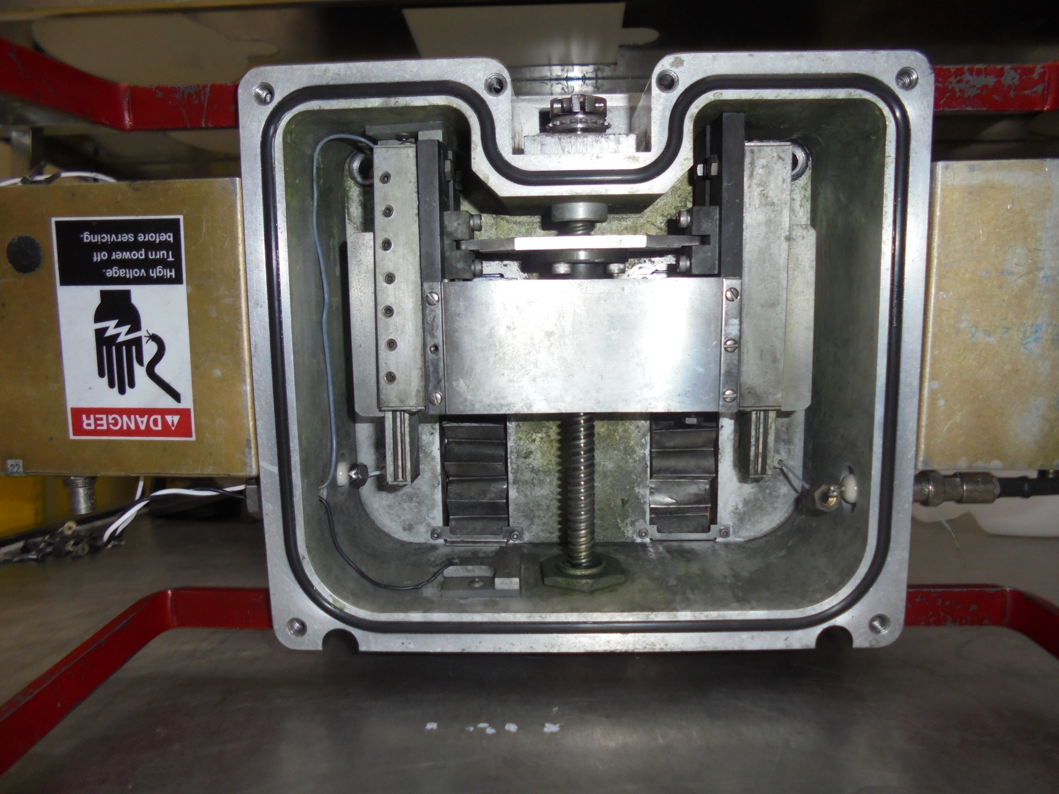
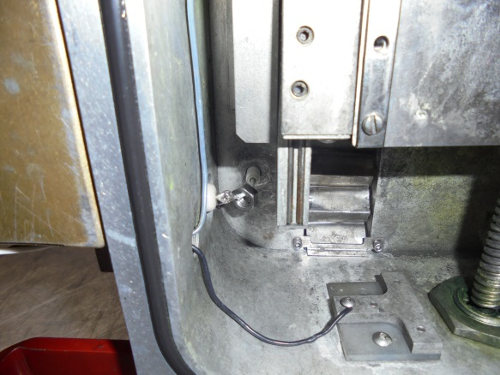
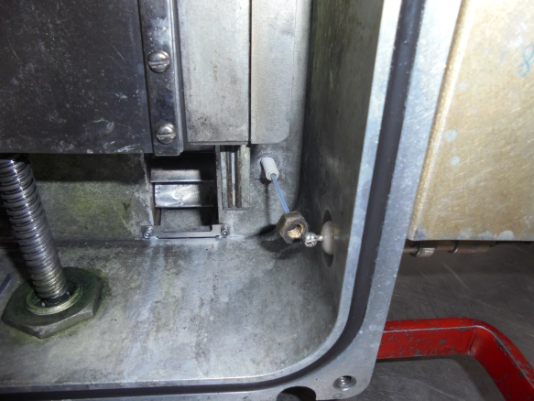
Tighten The Female Nut

Slide 9
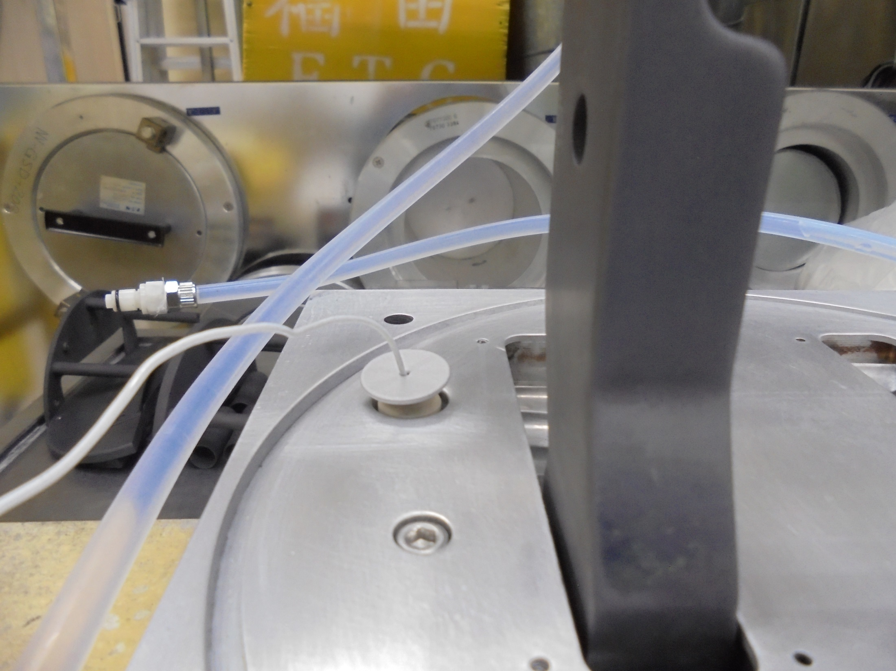
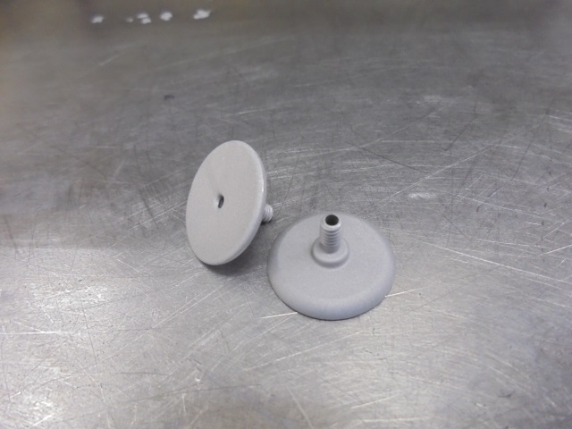
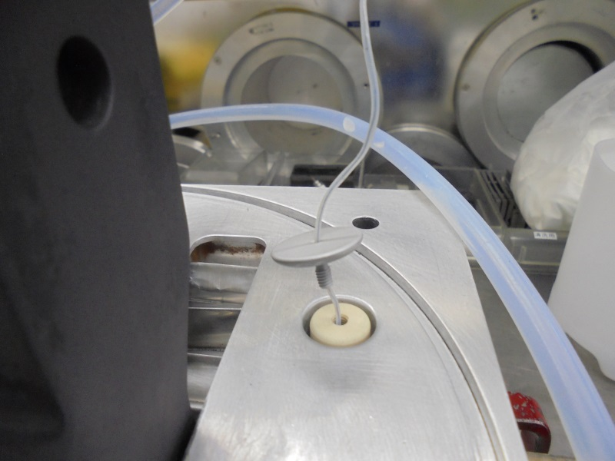
Insert / Install
FEED-THRU SHIELD
Here!

Slide 10
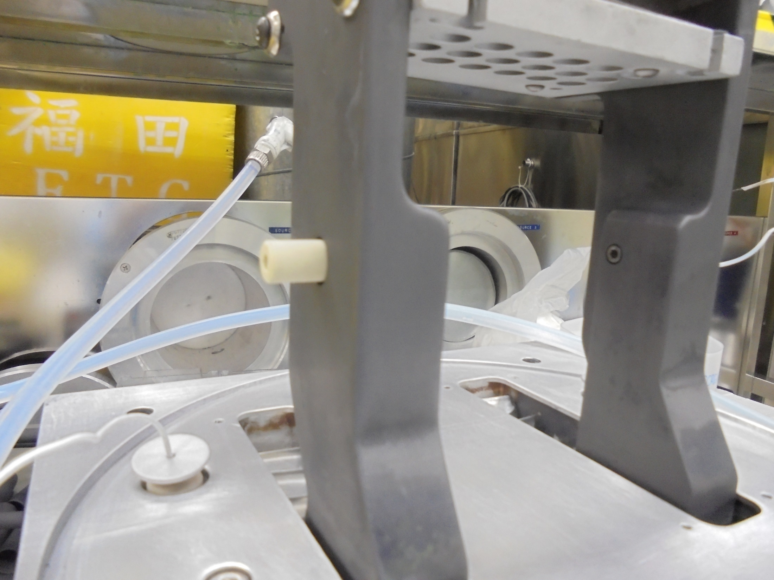
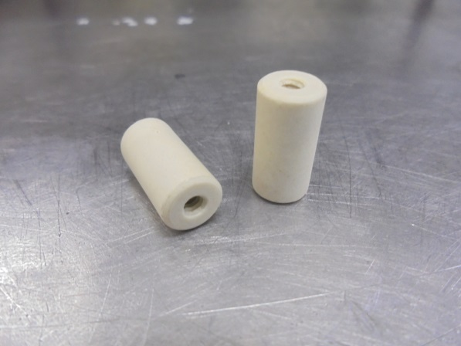
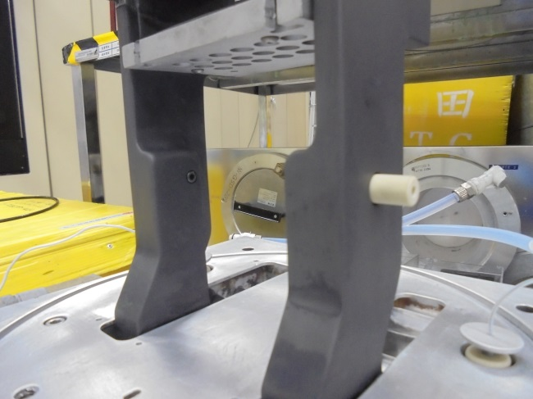
INSULATOR
Other side
( secure with screws )
Here!

Slide 11
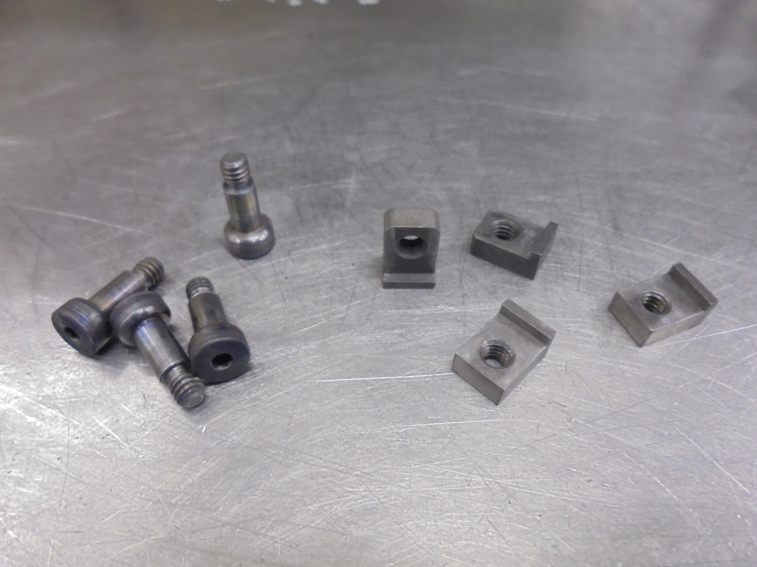

Slide 12
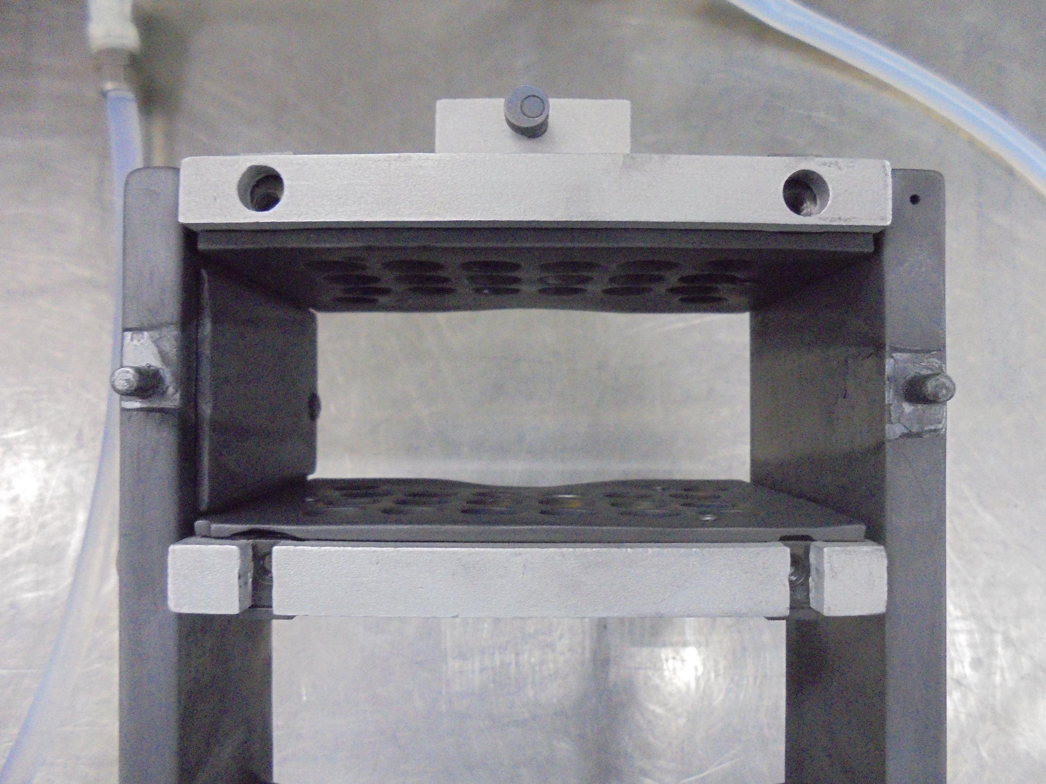


Slide 13
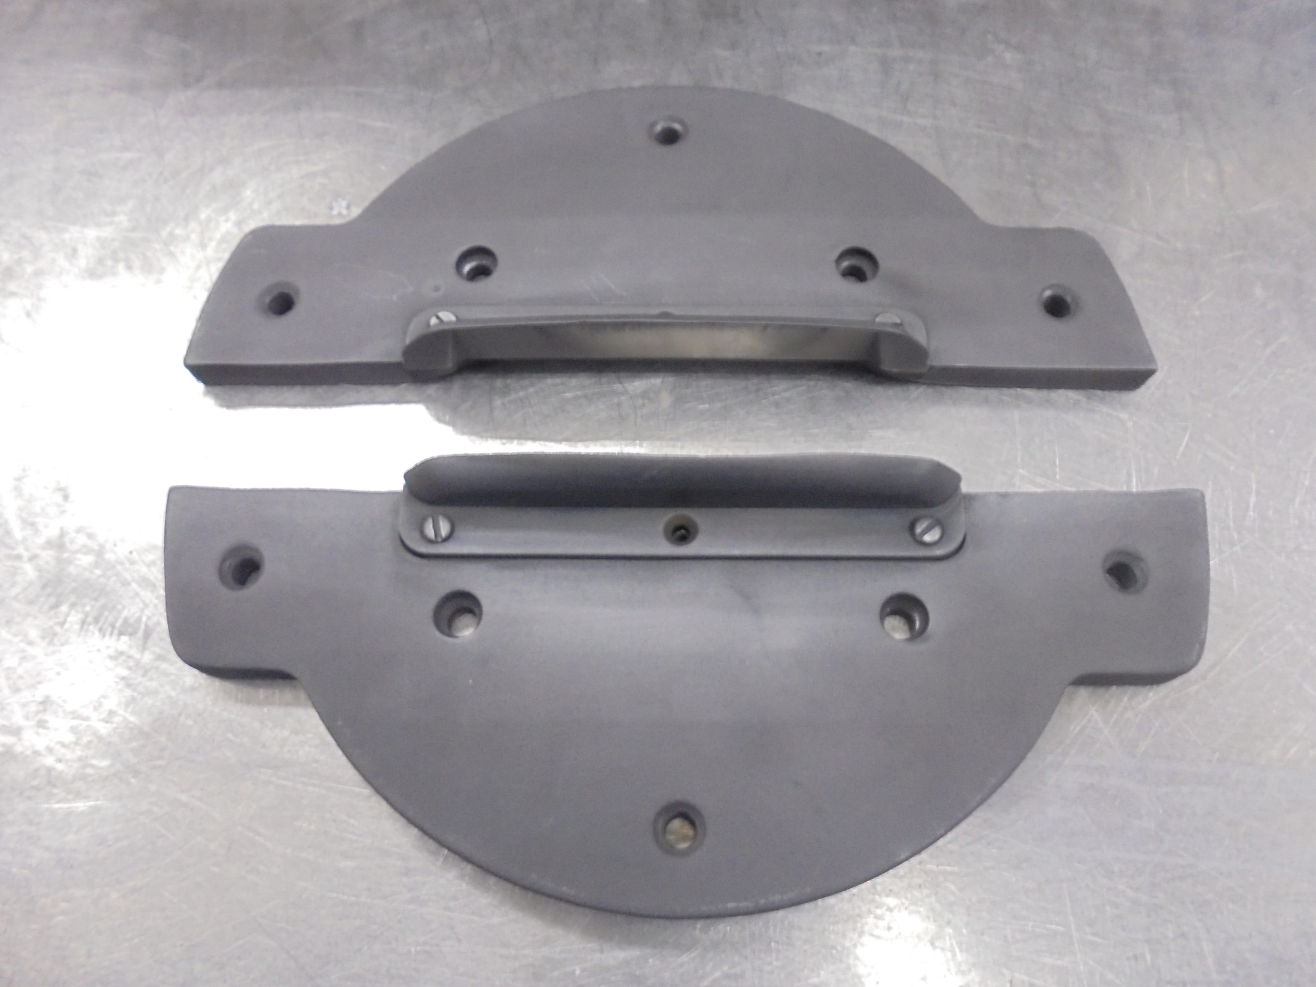
GROUND PLATE (Graphite)

Slide 14
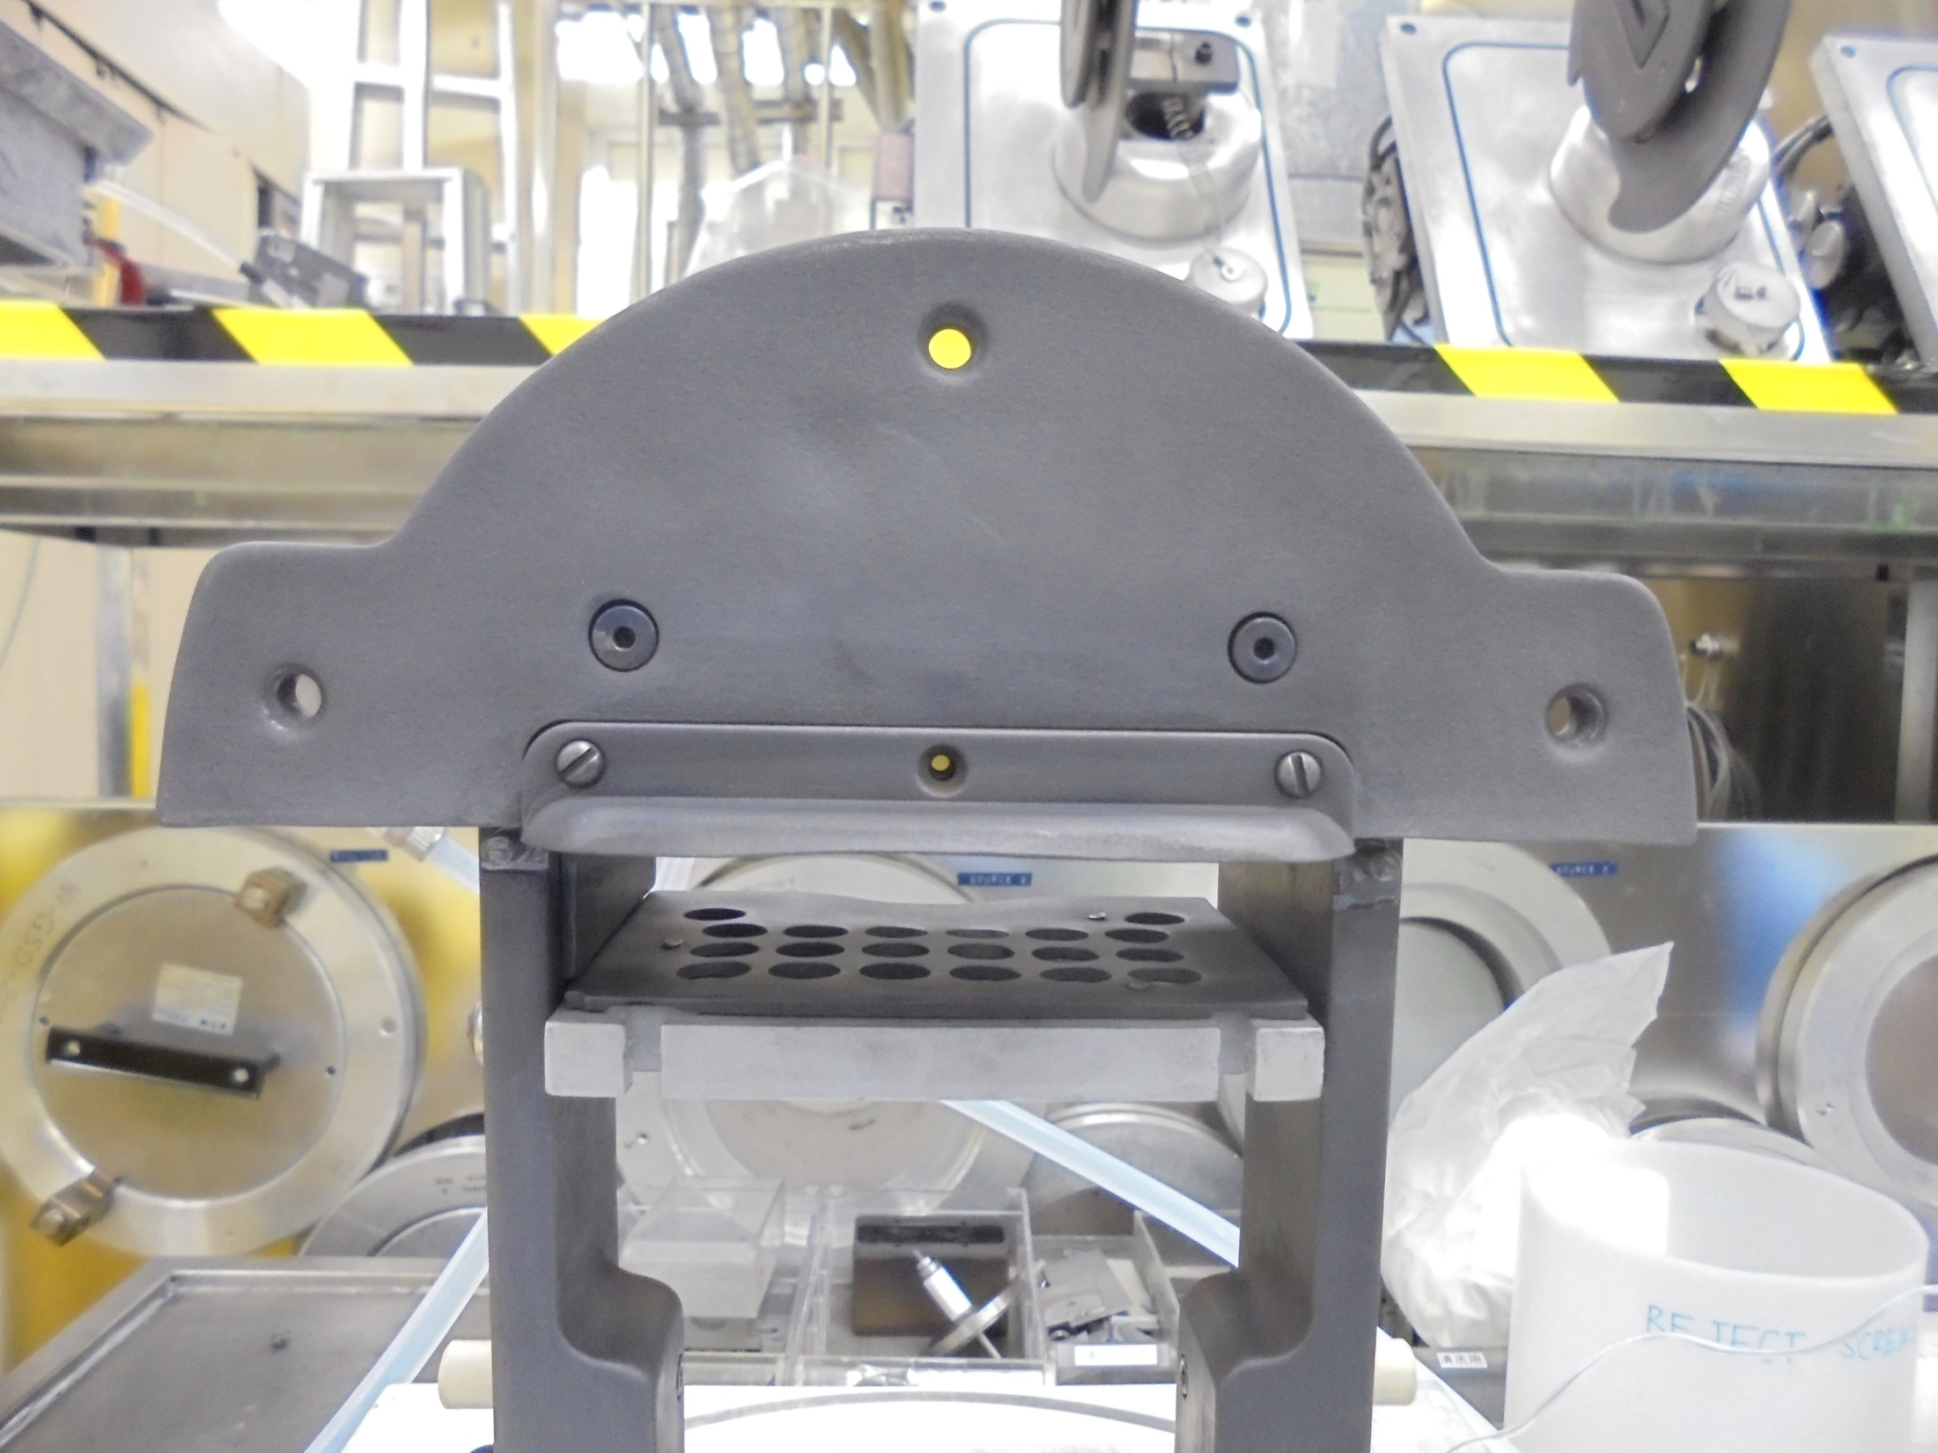

Install

Slide 15
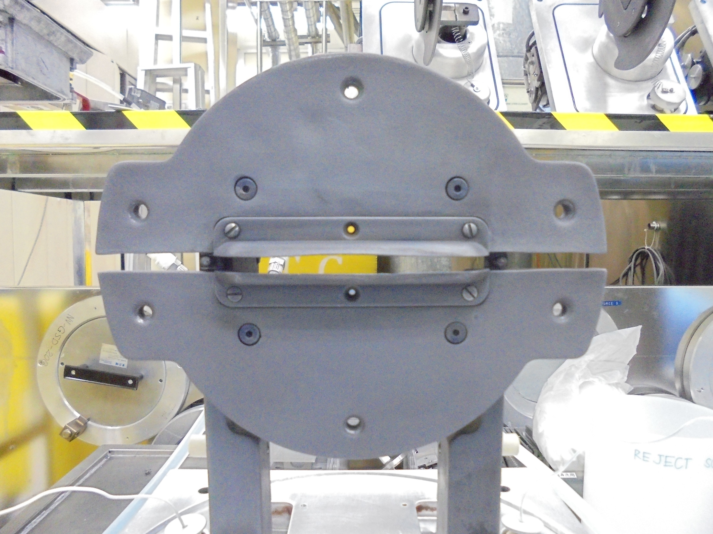
Install the other part here at the bottom

Slide 16
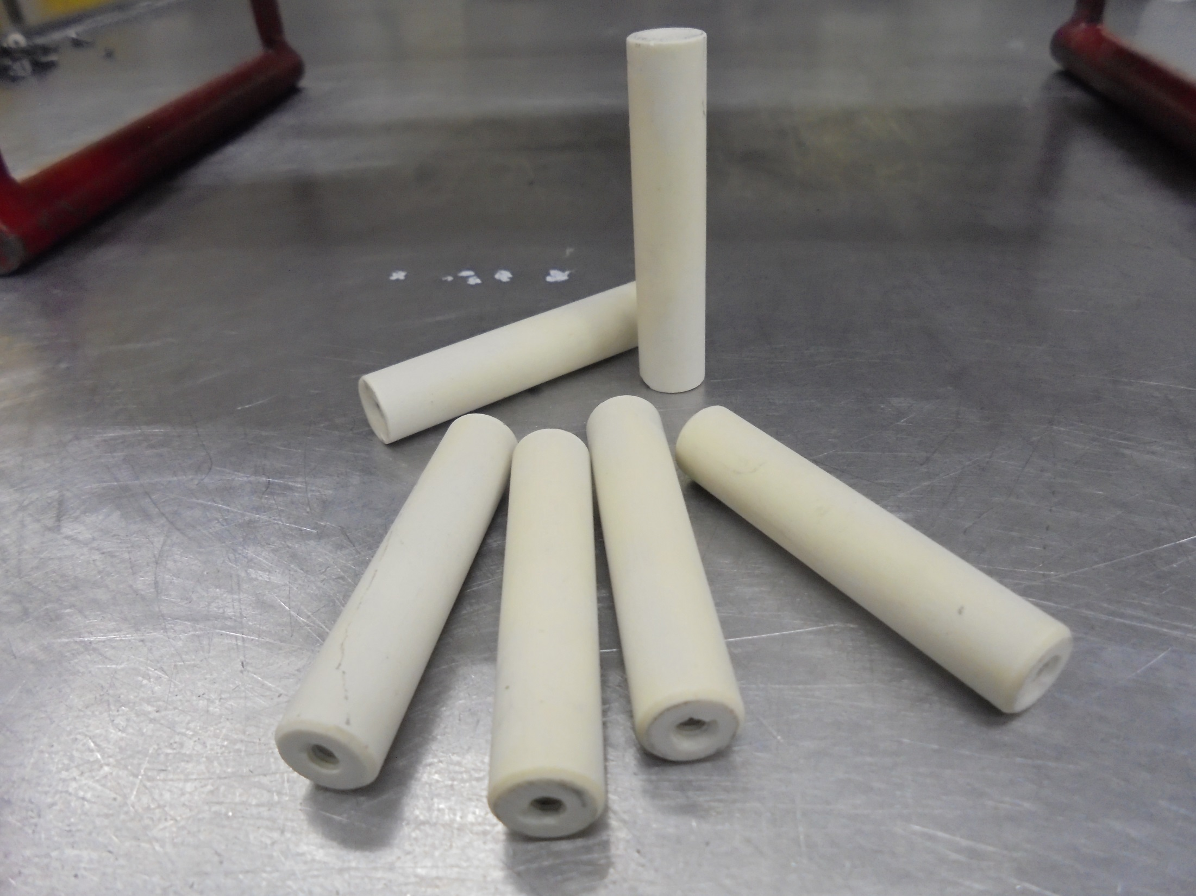
SPACER INSULATOR

Slide 17
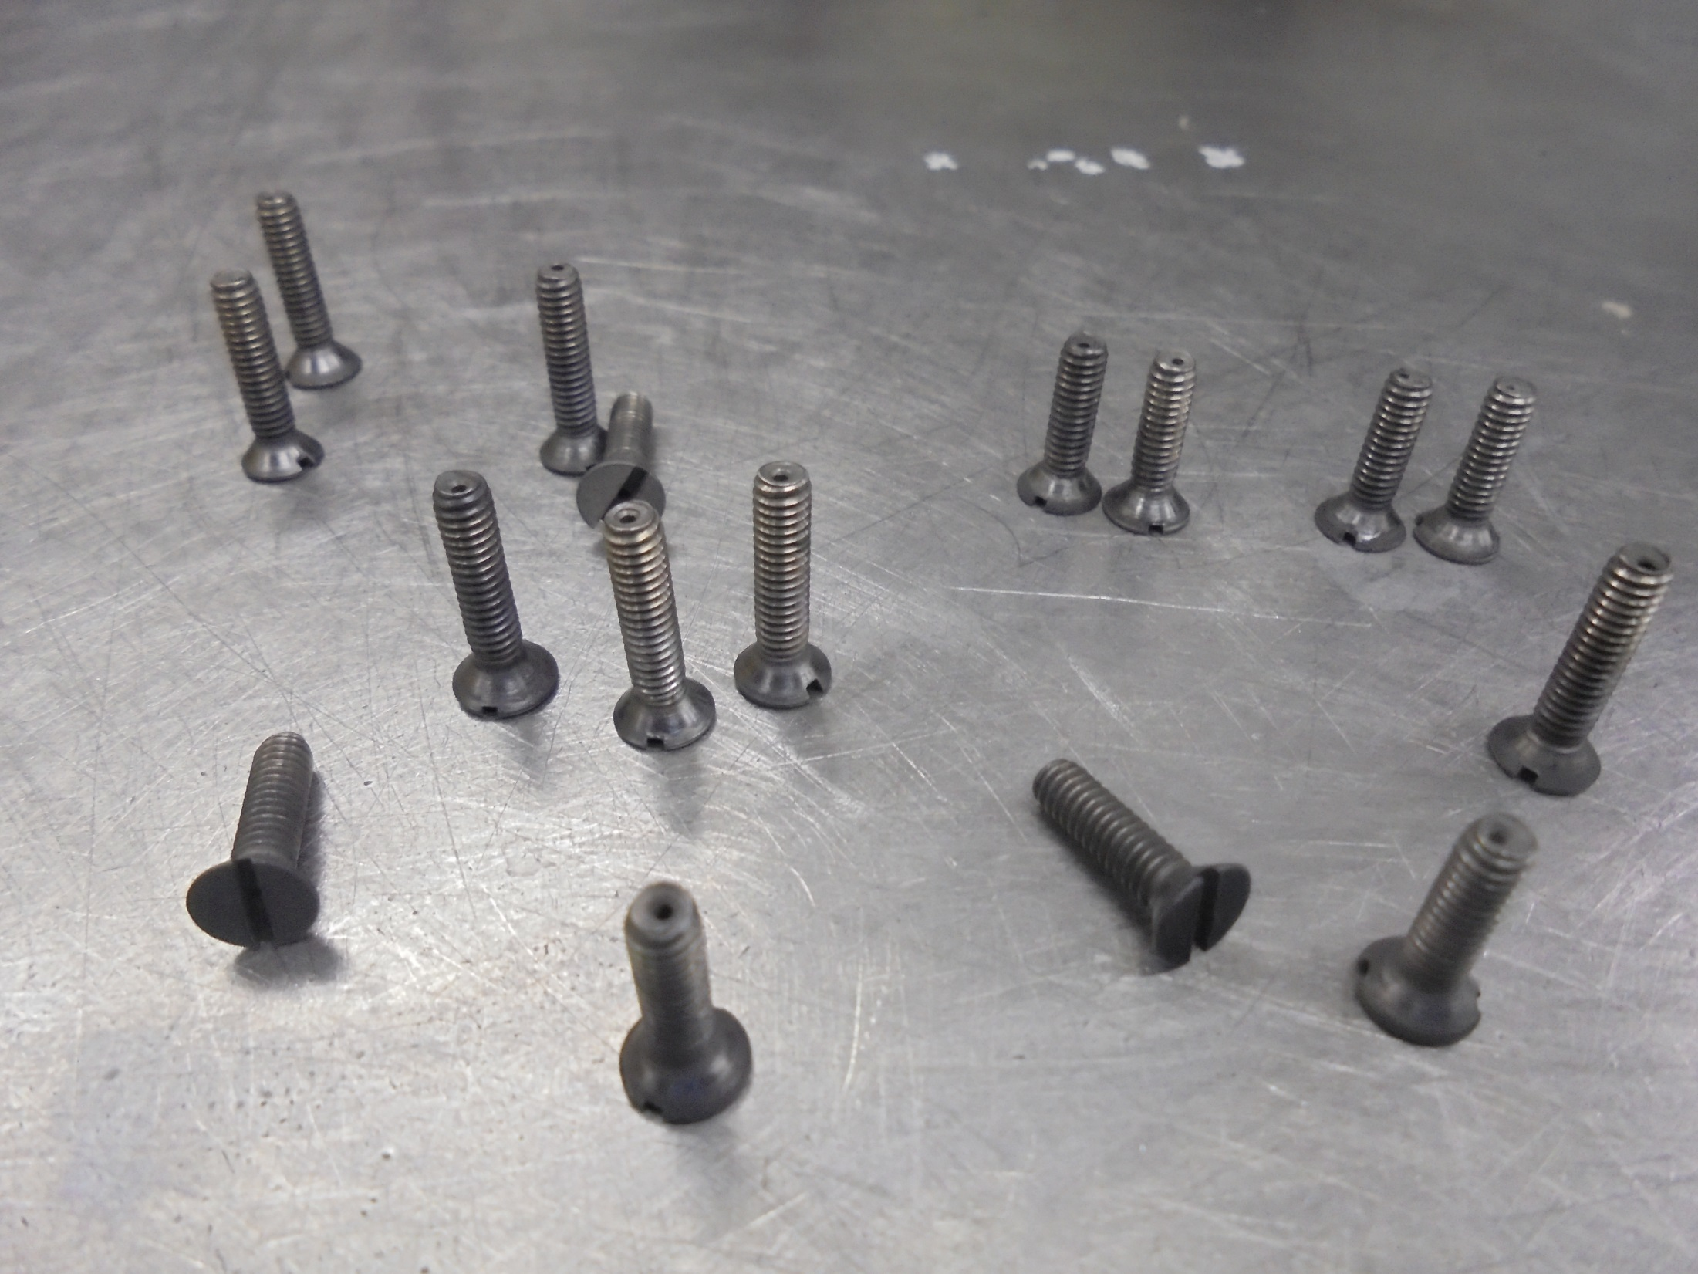
SCREWS

Slide 18
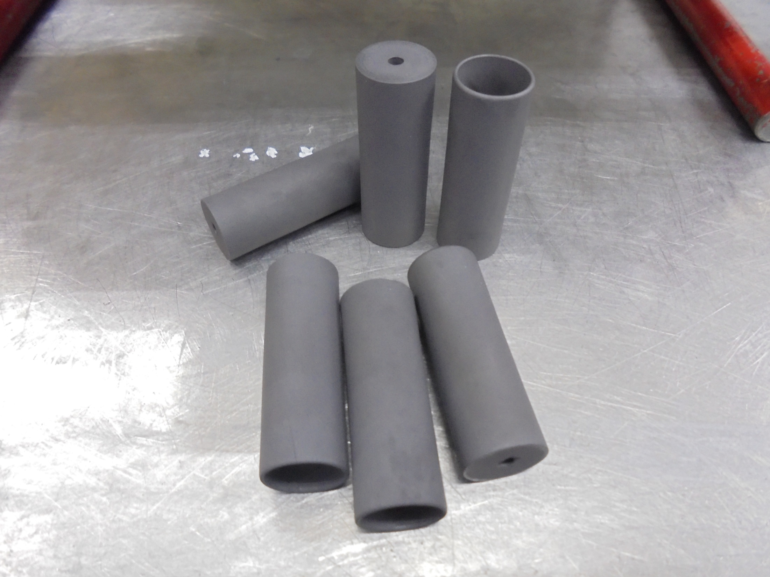
SHIELD (Graphite)

Slide 19
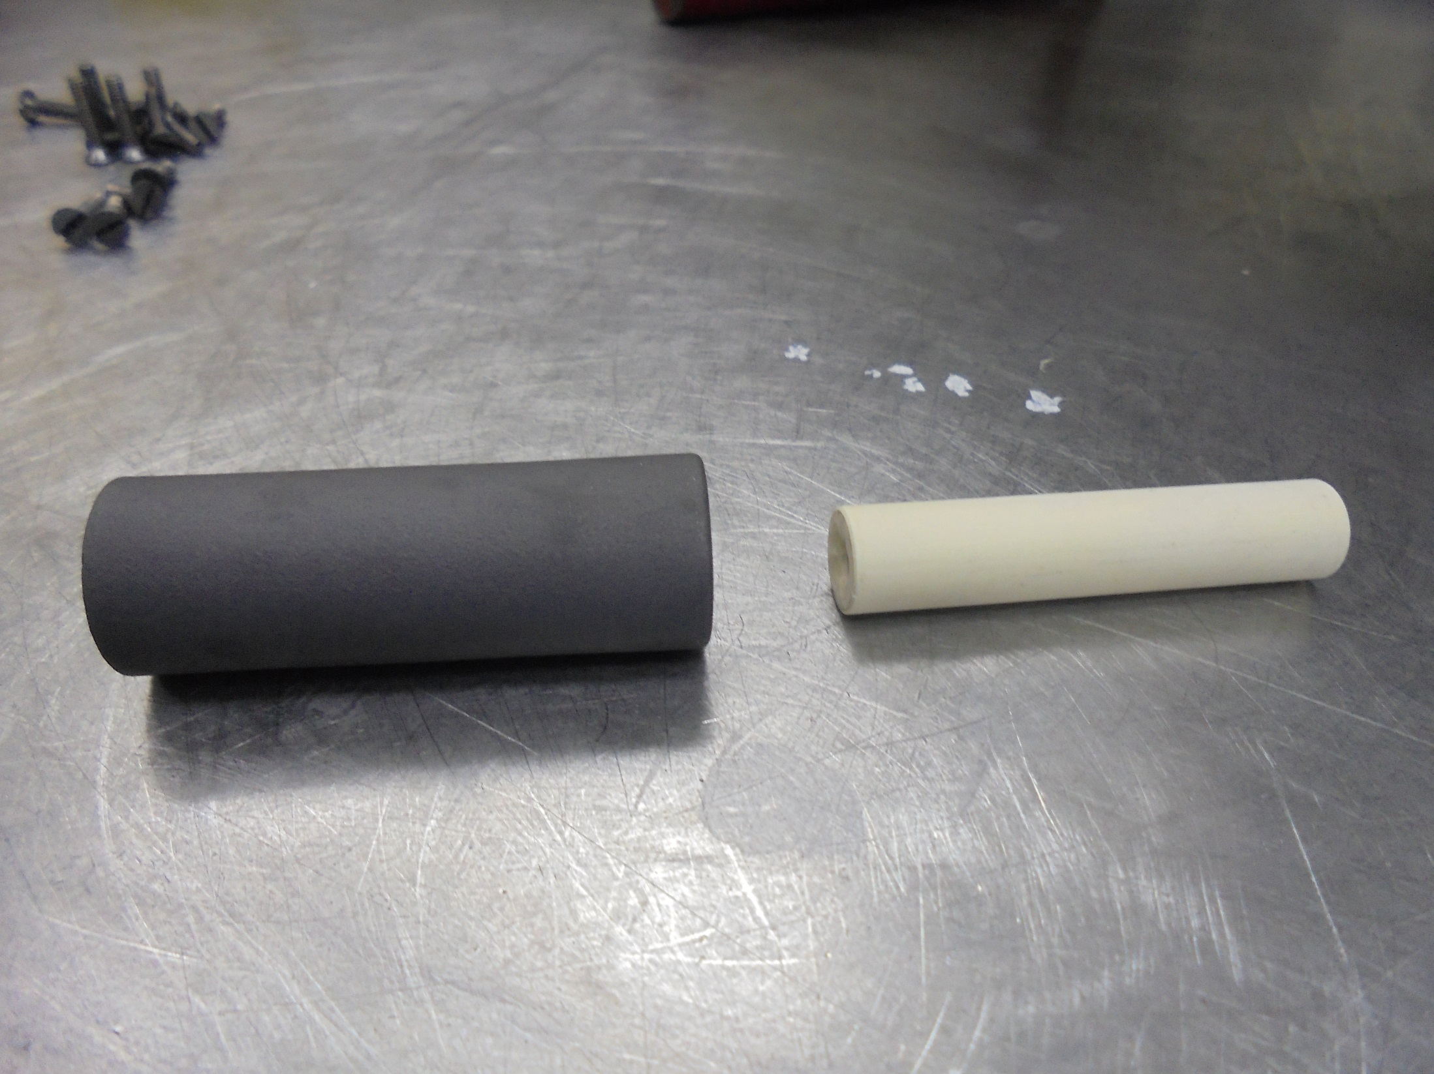
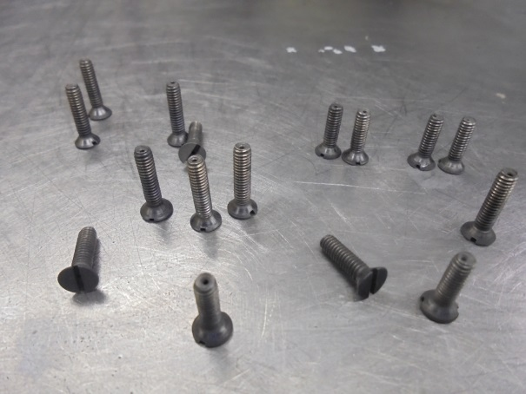
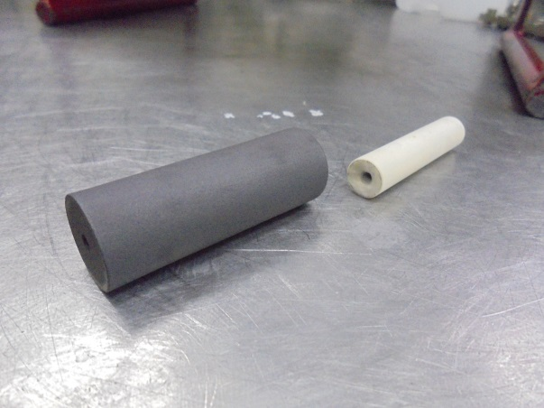
Designated Screws
Shield and Spacer Insulator
Insert inside!

Slide 20
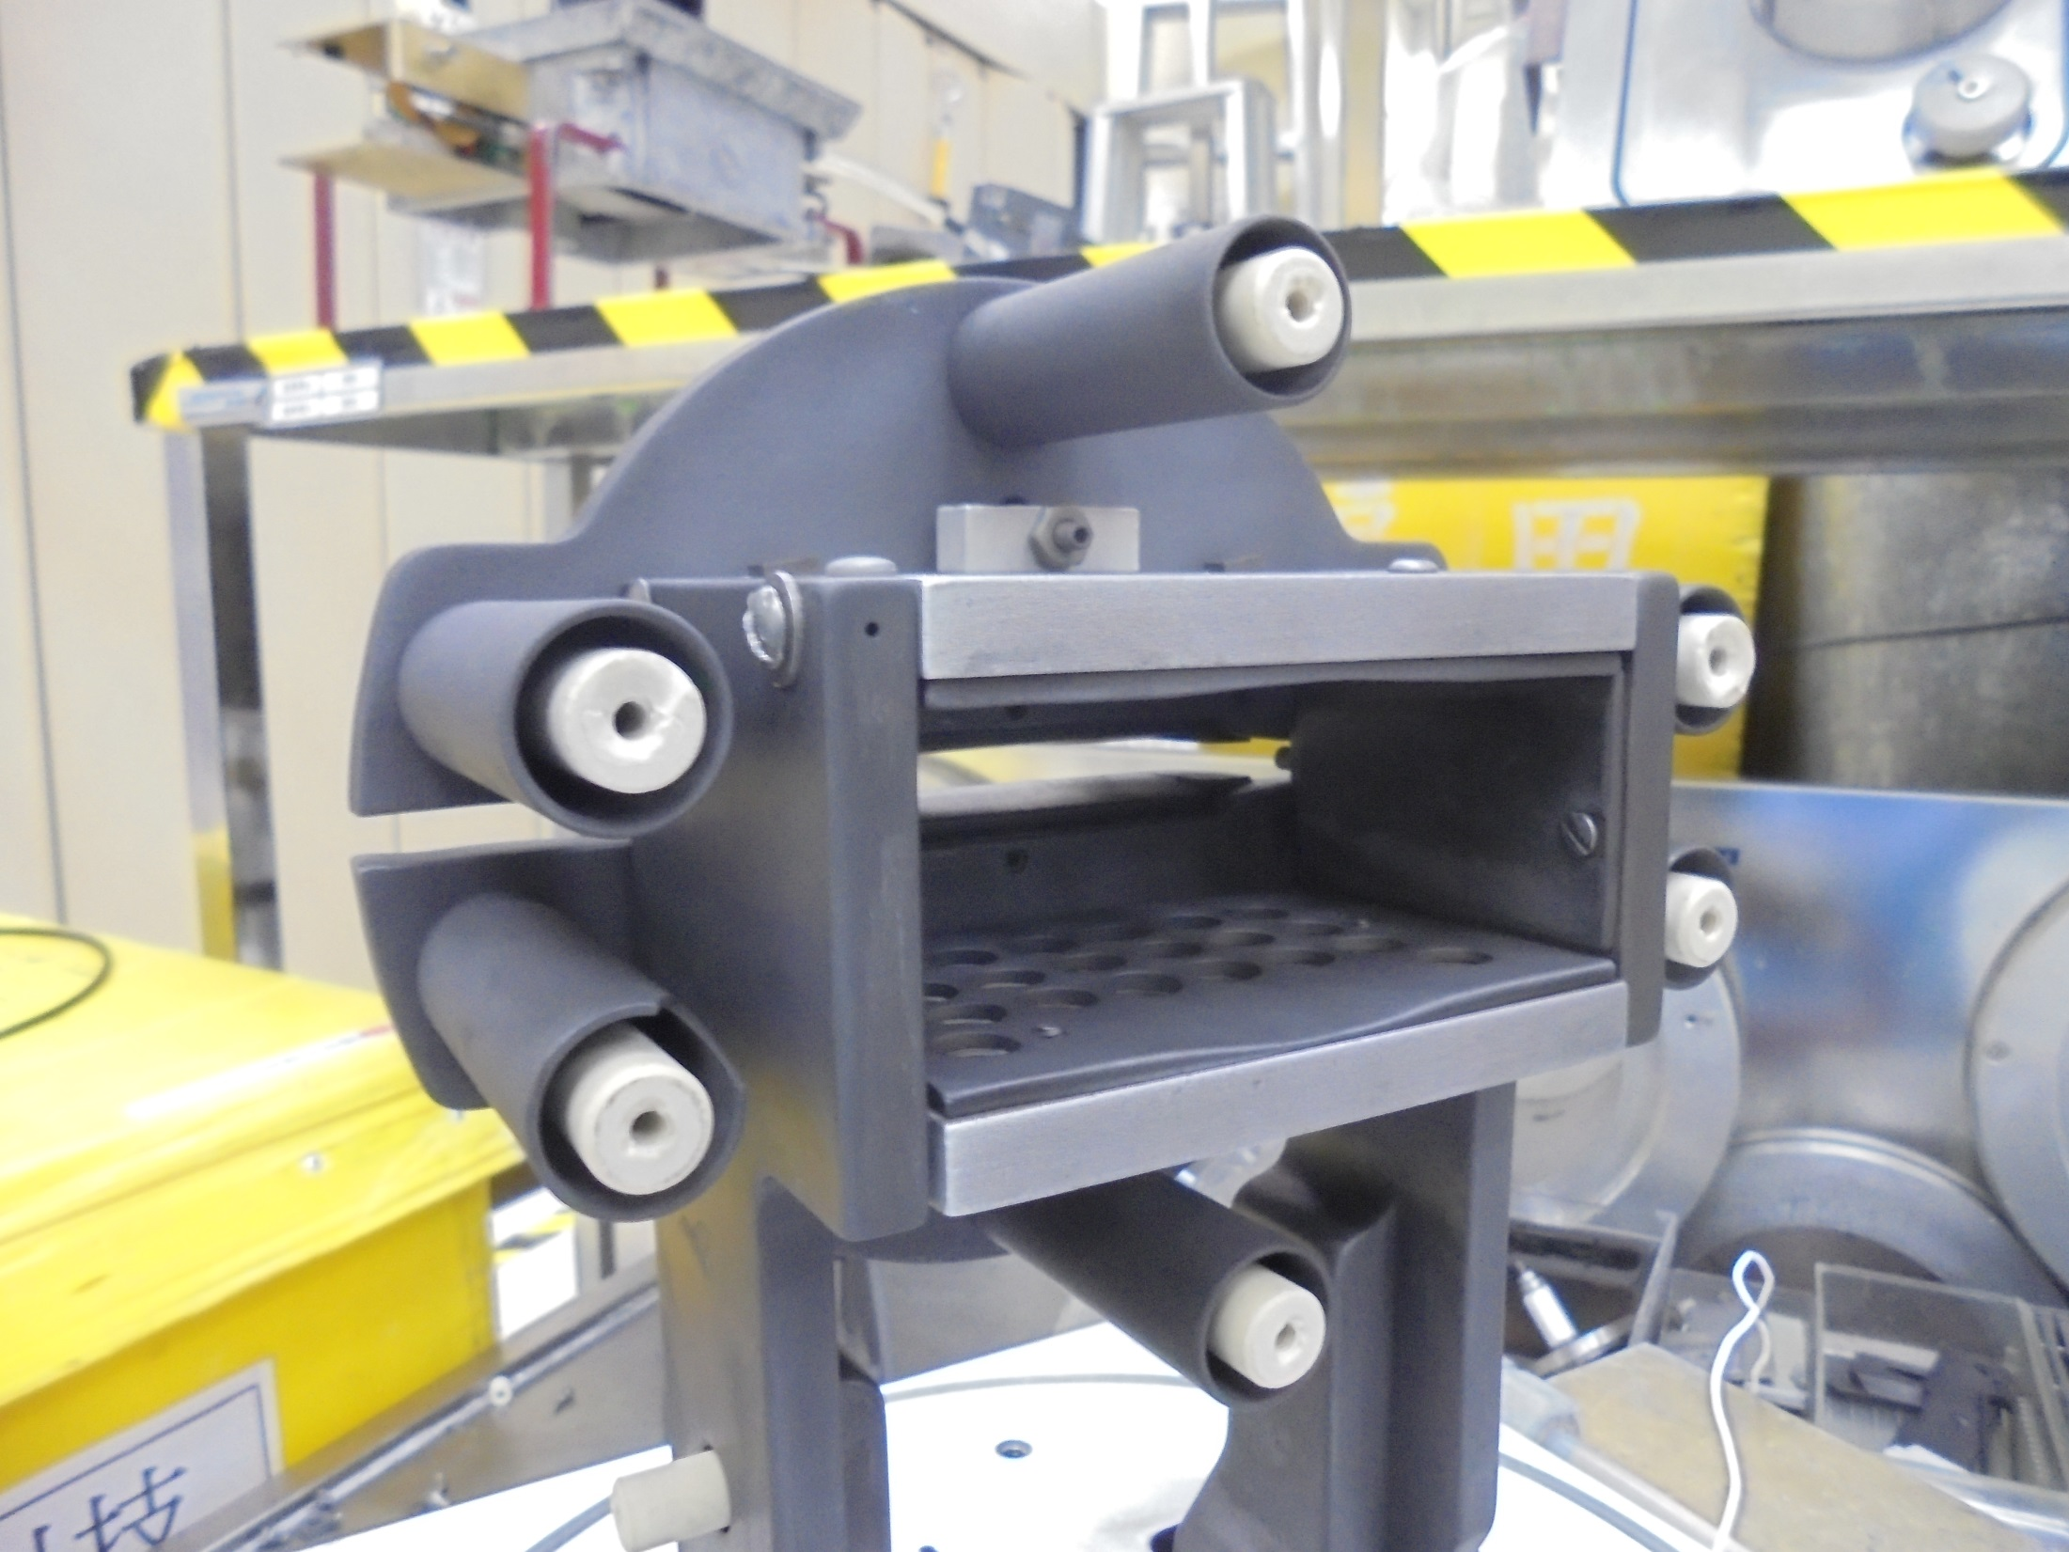
Install on this area and secure with screws

Slide 21
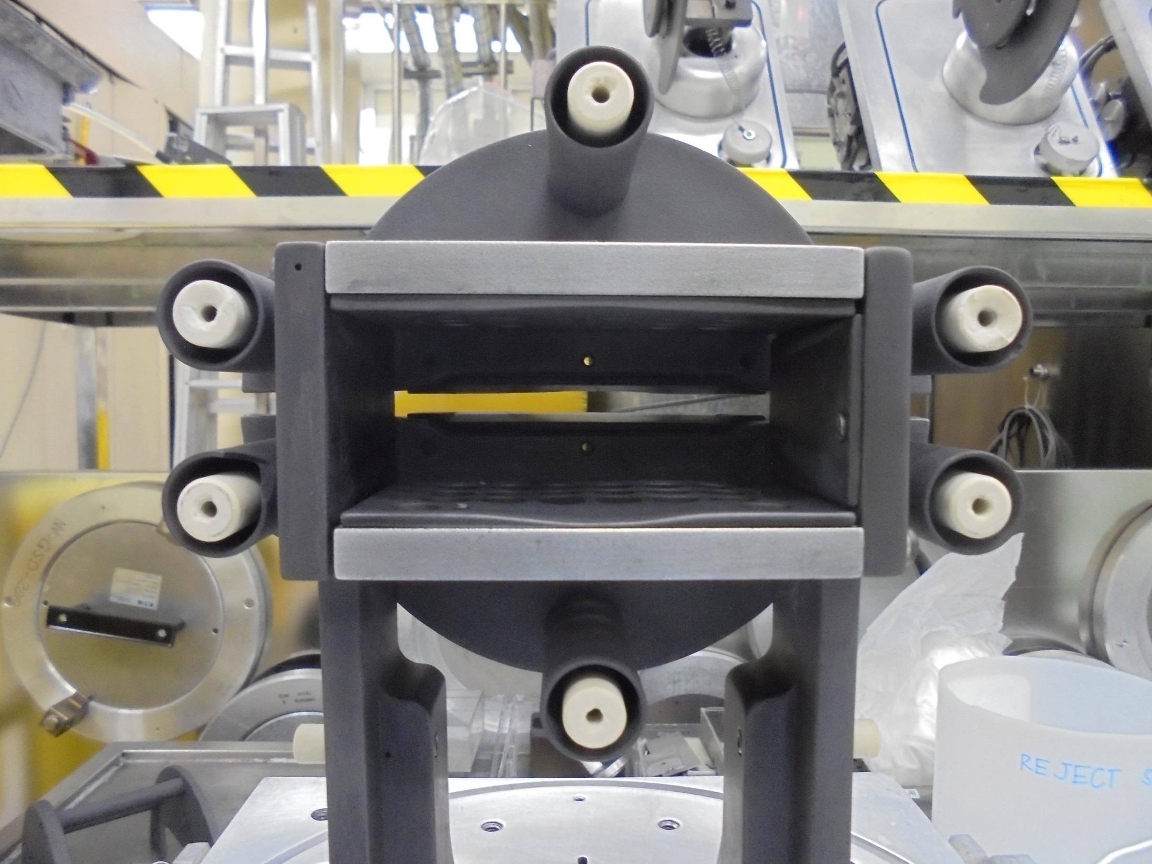
GROUND PLATE (Graphite)

Slide 22
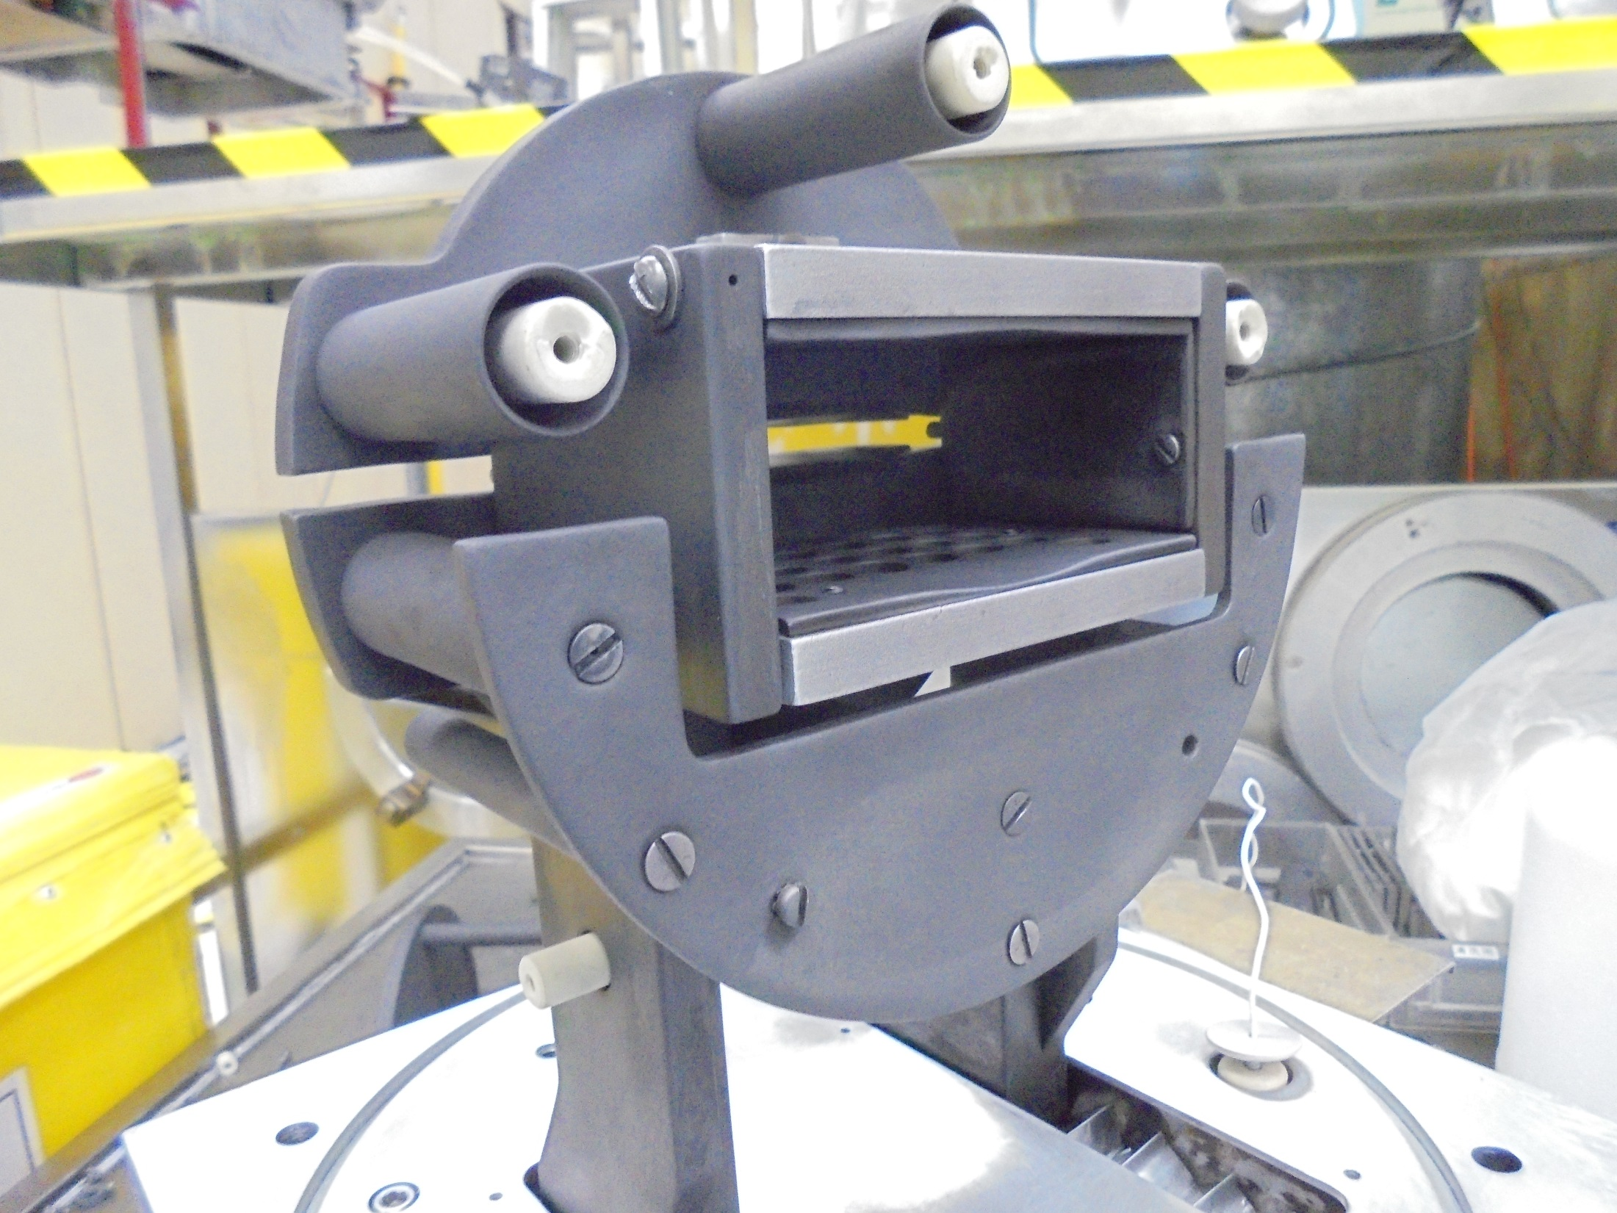
Install the BOTTOM END PLATE

Slide 23
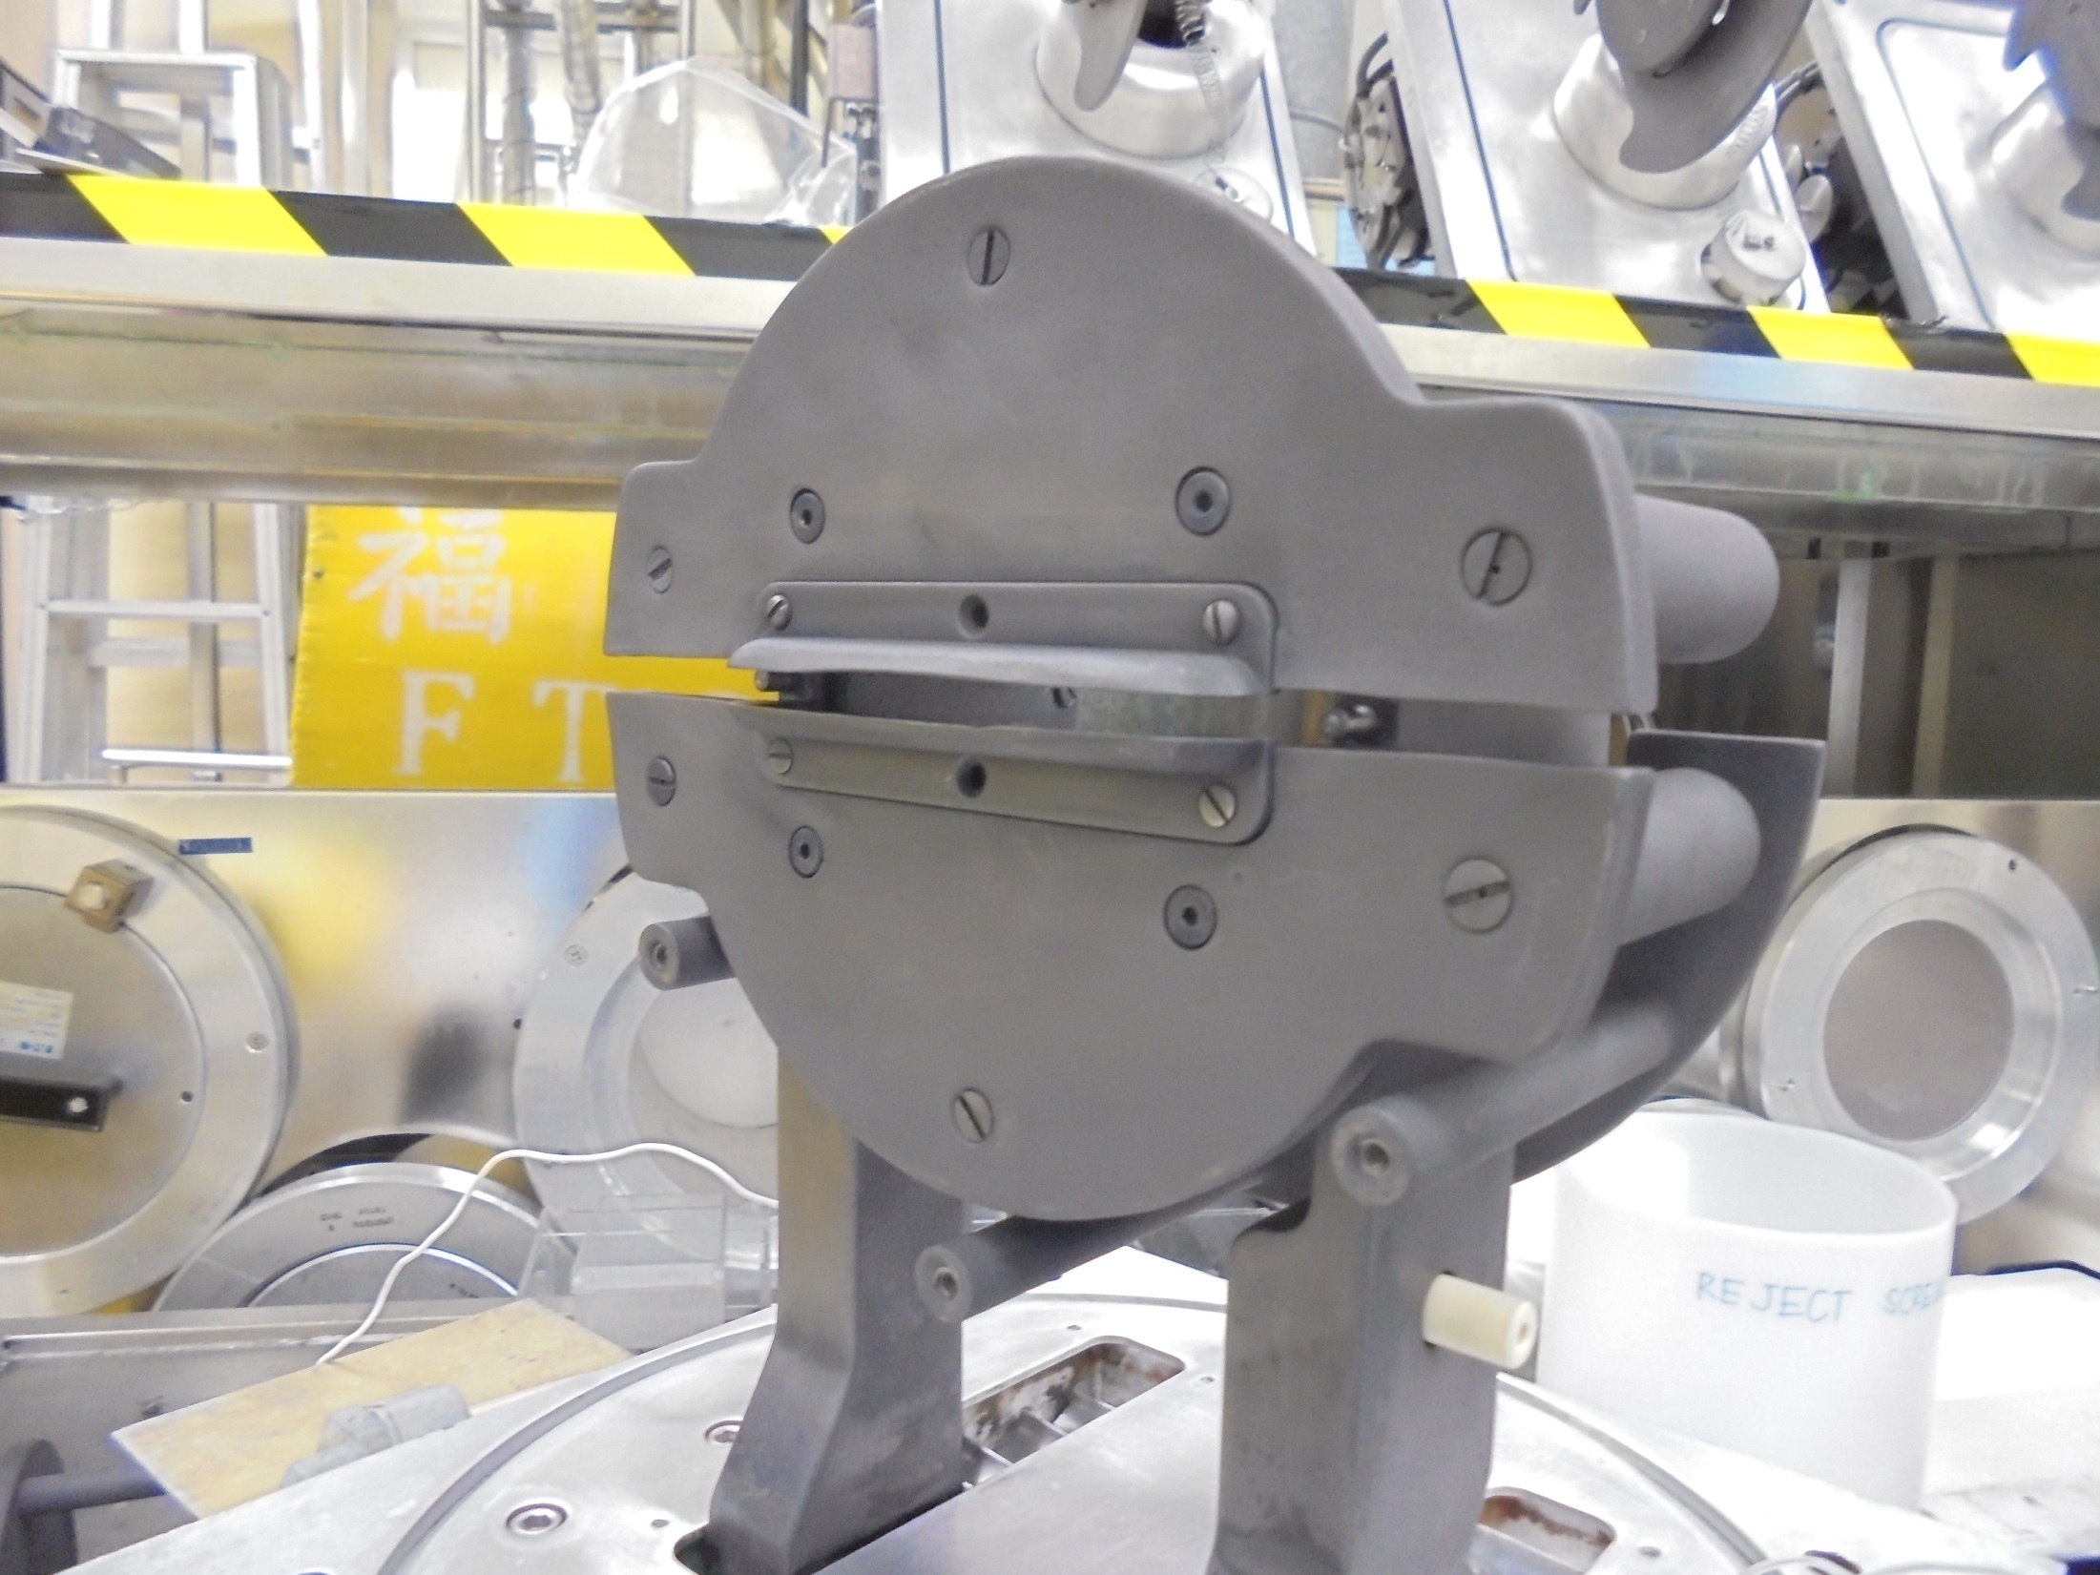
Install EXTRACTION PLATE
Here!

Slide 24
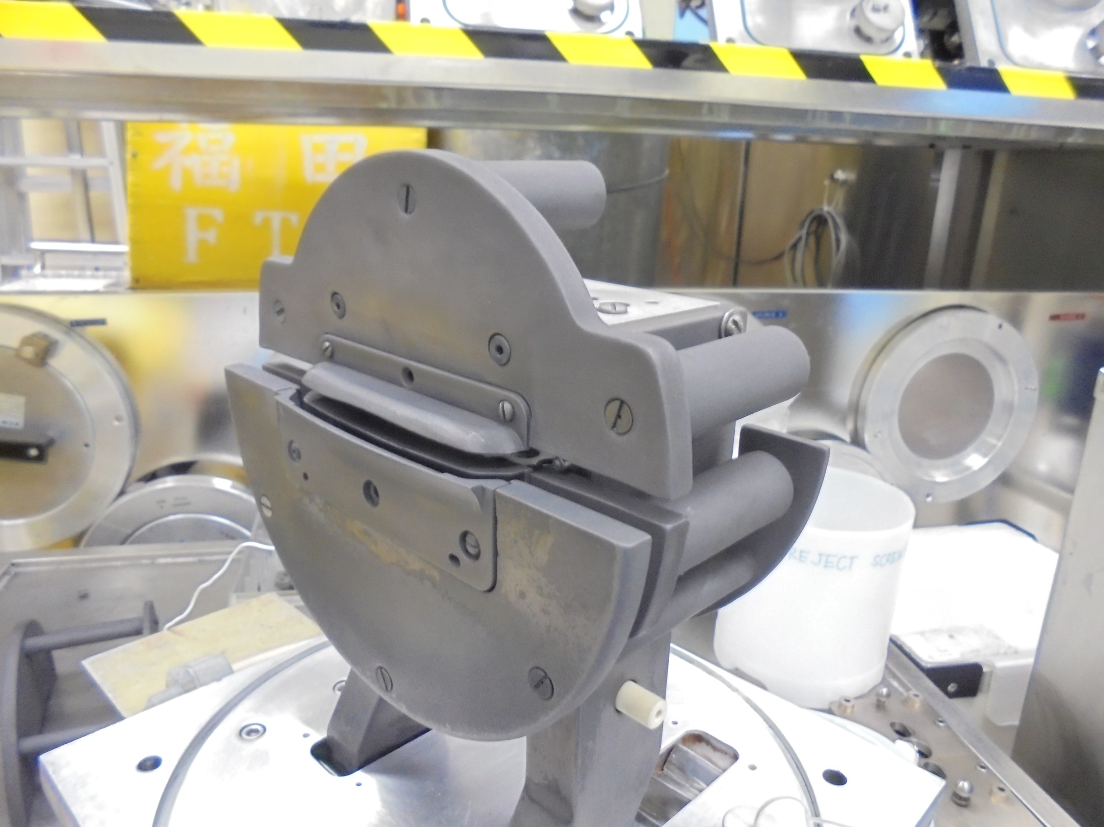
EXTRACTION PLATE [BOTTOM]

Slide 25
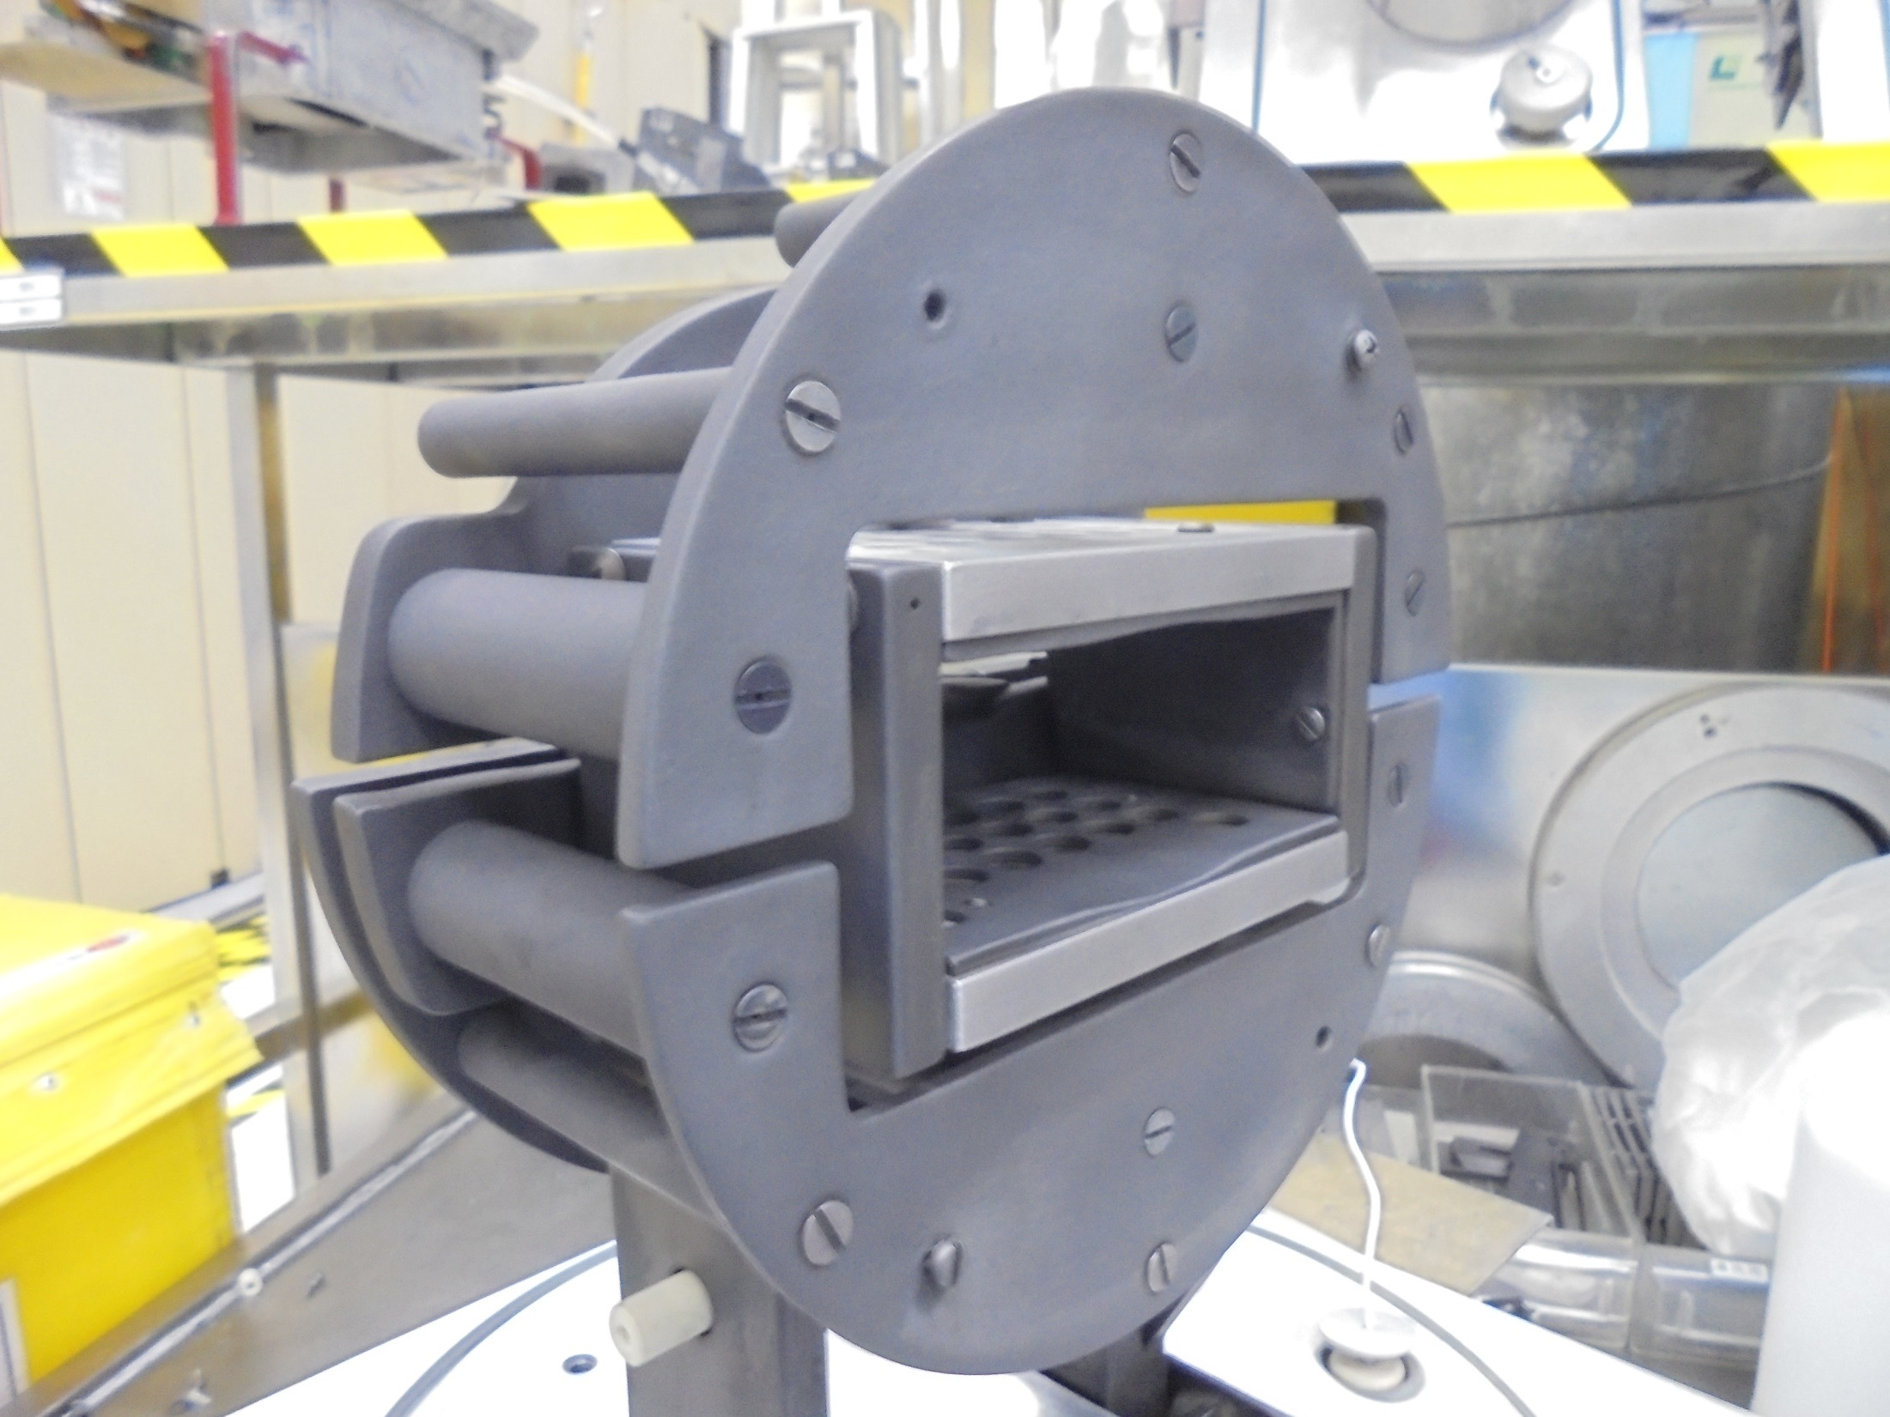
Install the UPPER END PLATE

Slide 26
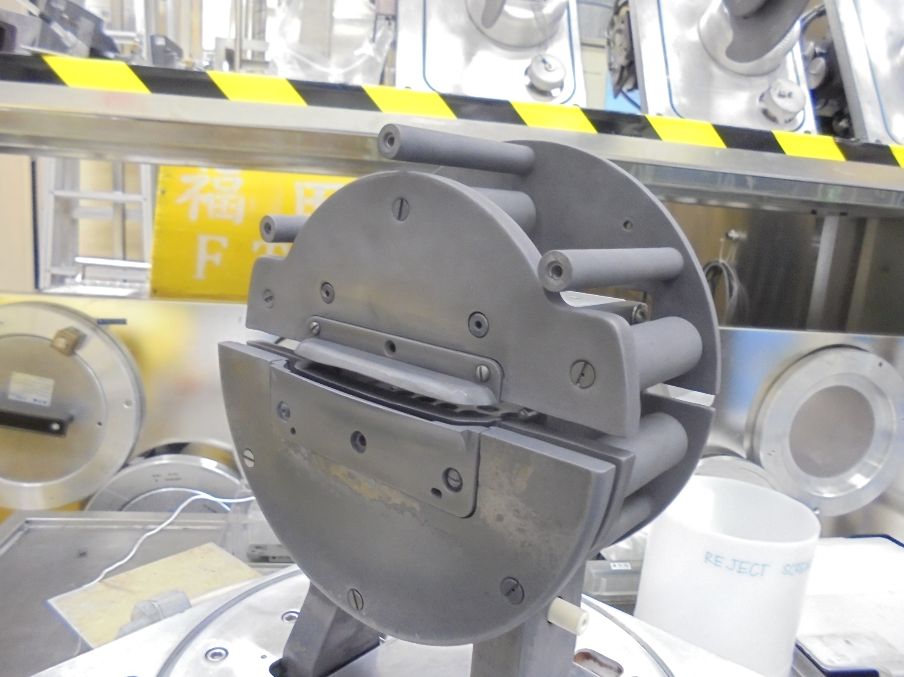
Install UPPER EXTRACTION PLATE
Here!

Slide 27
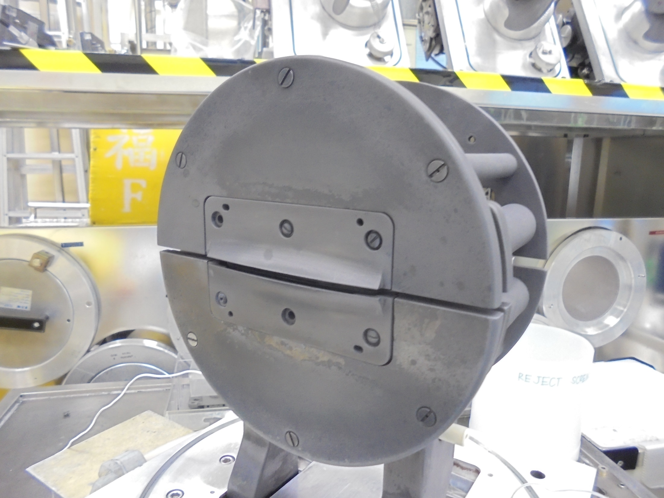
EXTRACTION PLATES
EXTRACTION APERTURE

Slide 28
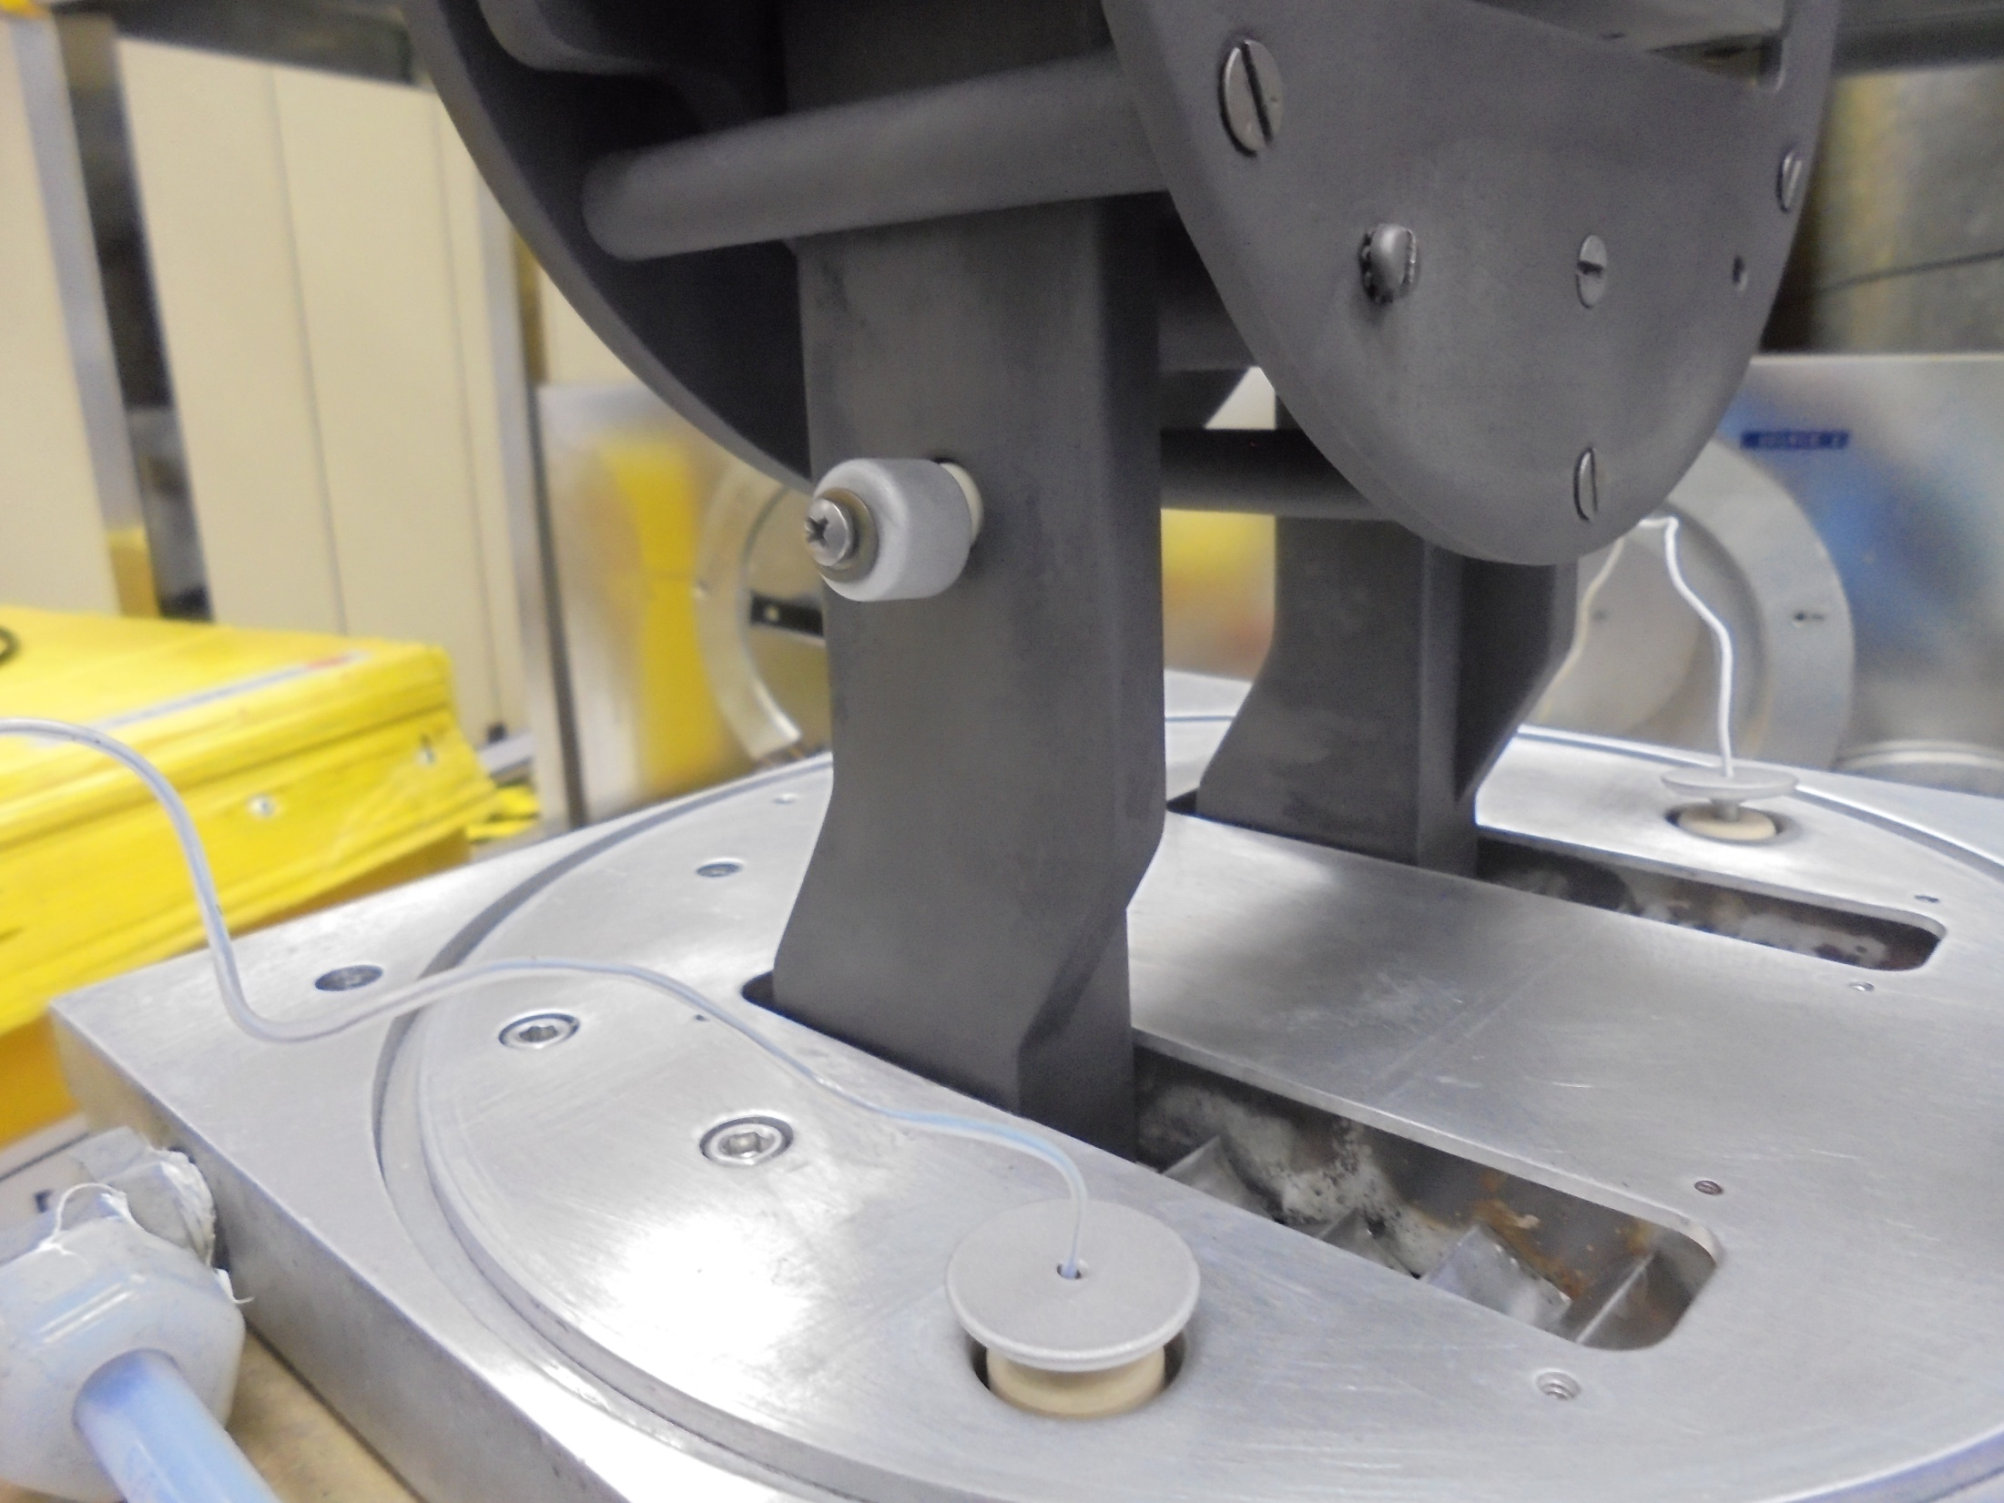
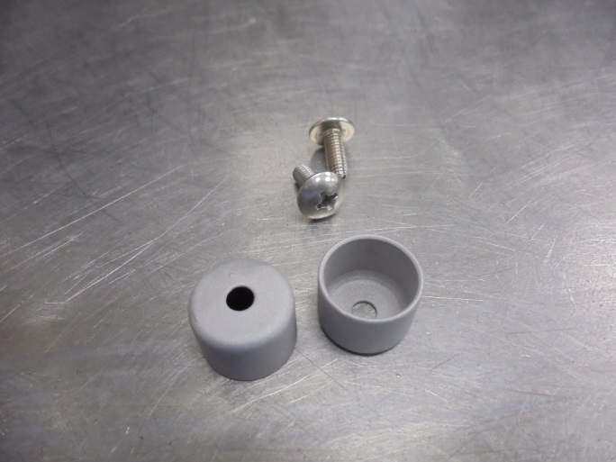
SHIELD INSULATOR
and
Screws

Slide 29
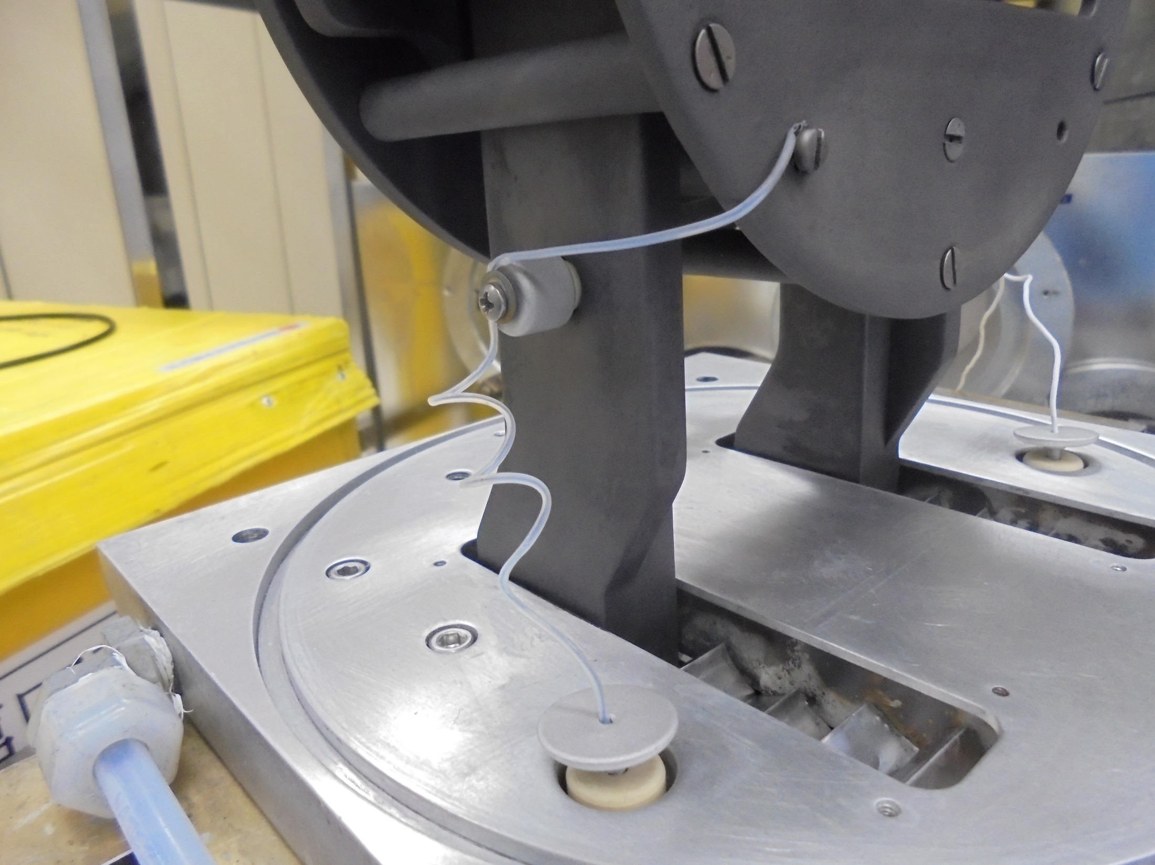
Attach TERMINAL Wire
(LOWER)

Slide 30
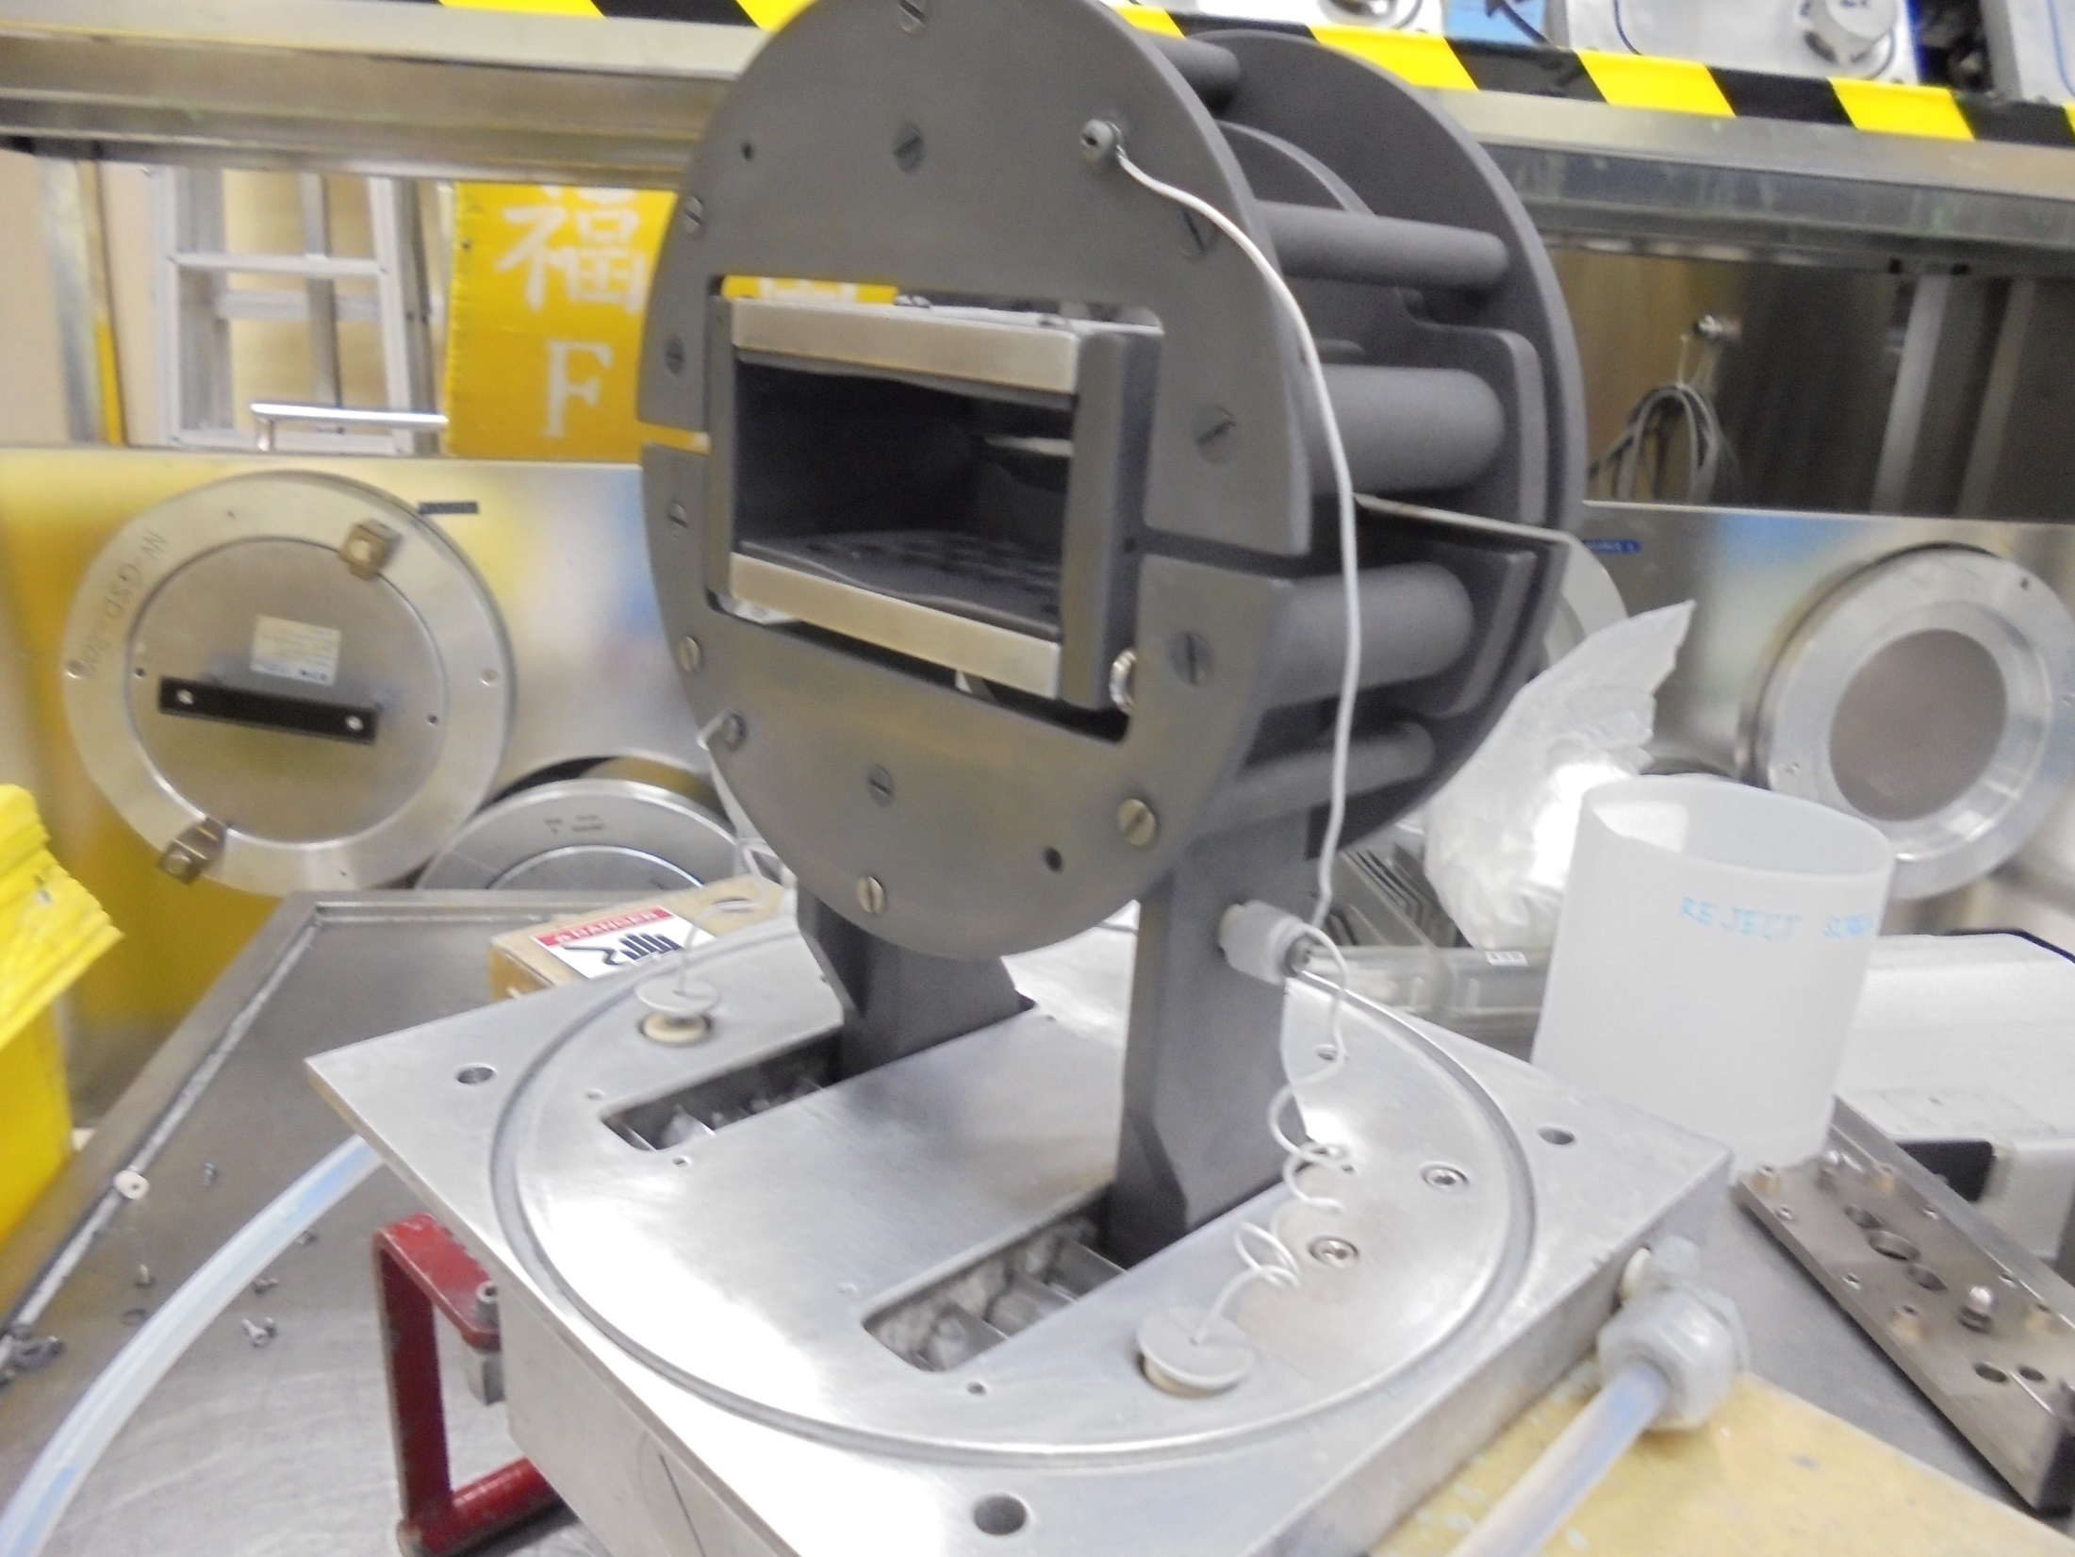
Attach TERMINAL Wire
(UPPER)

Slide 31
Calibration

Slide 32
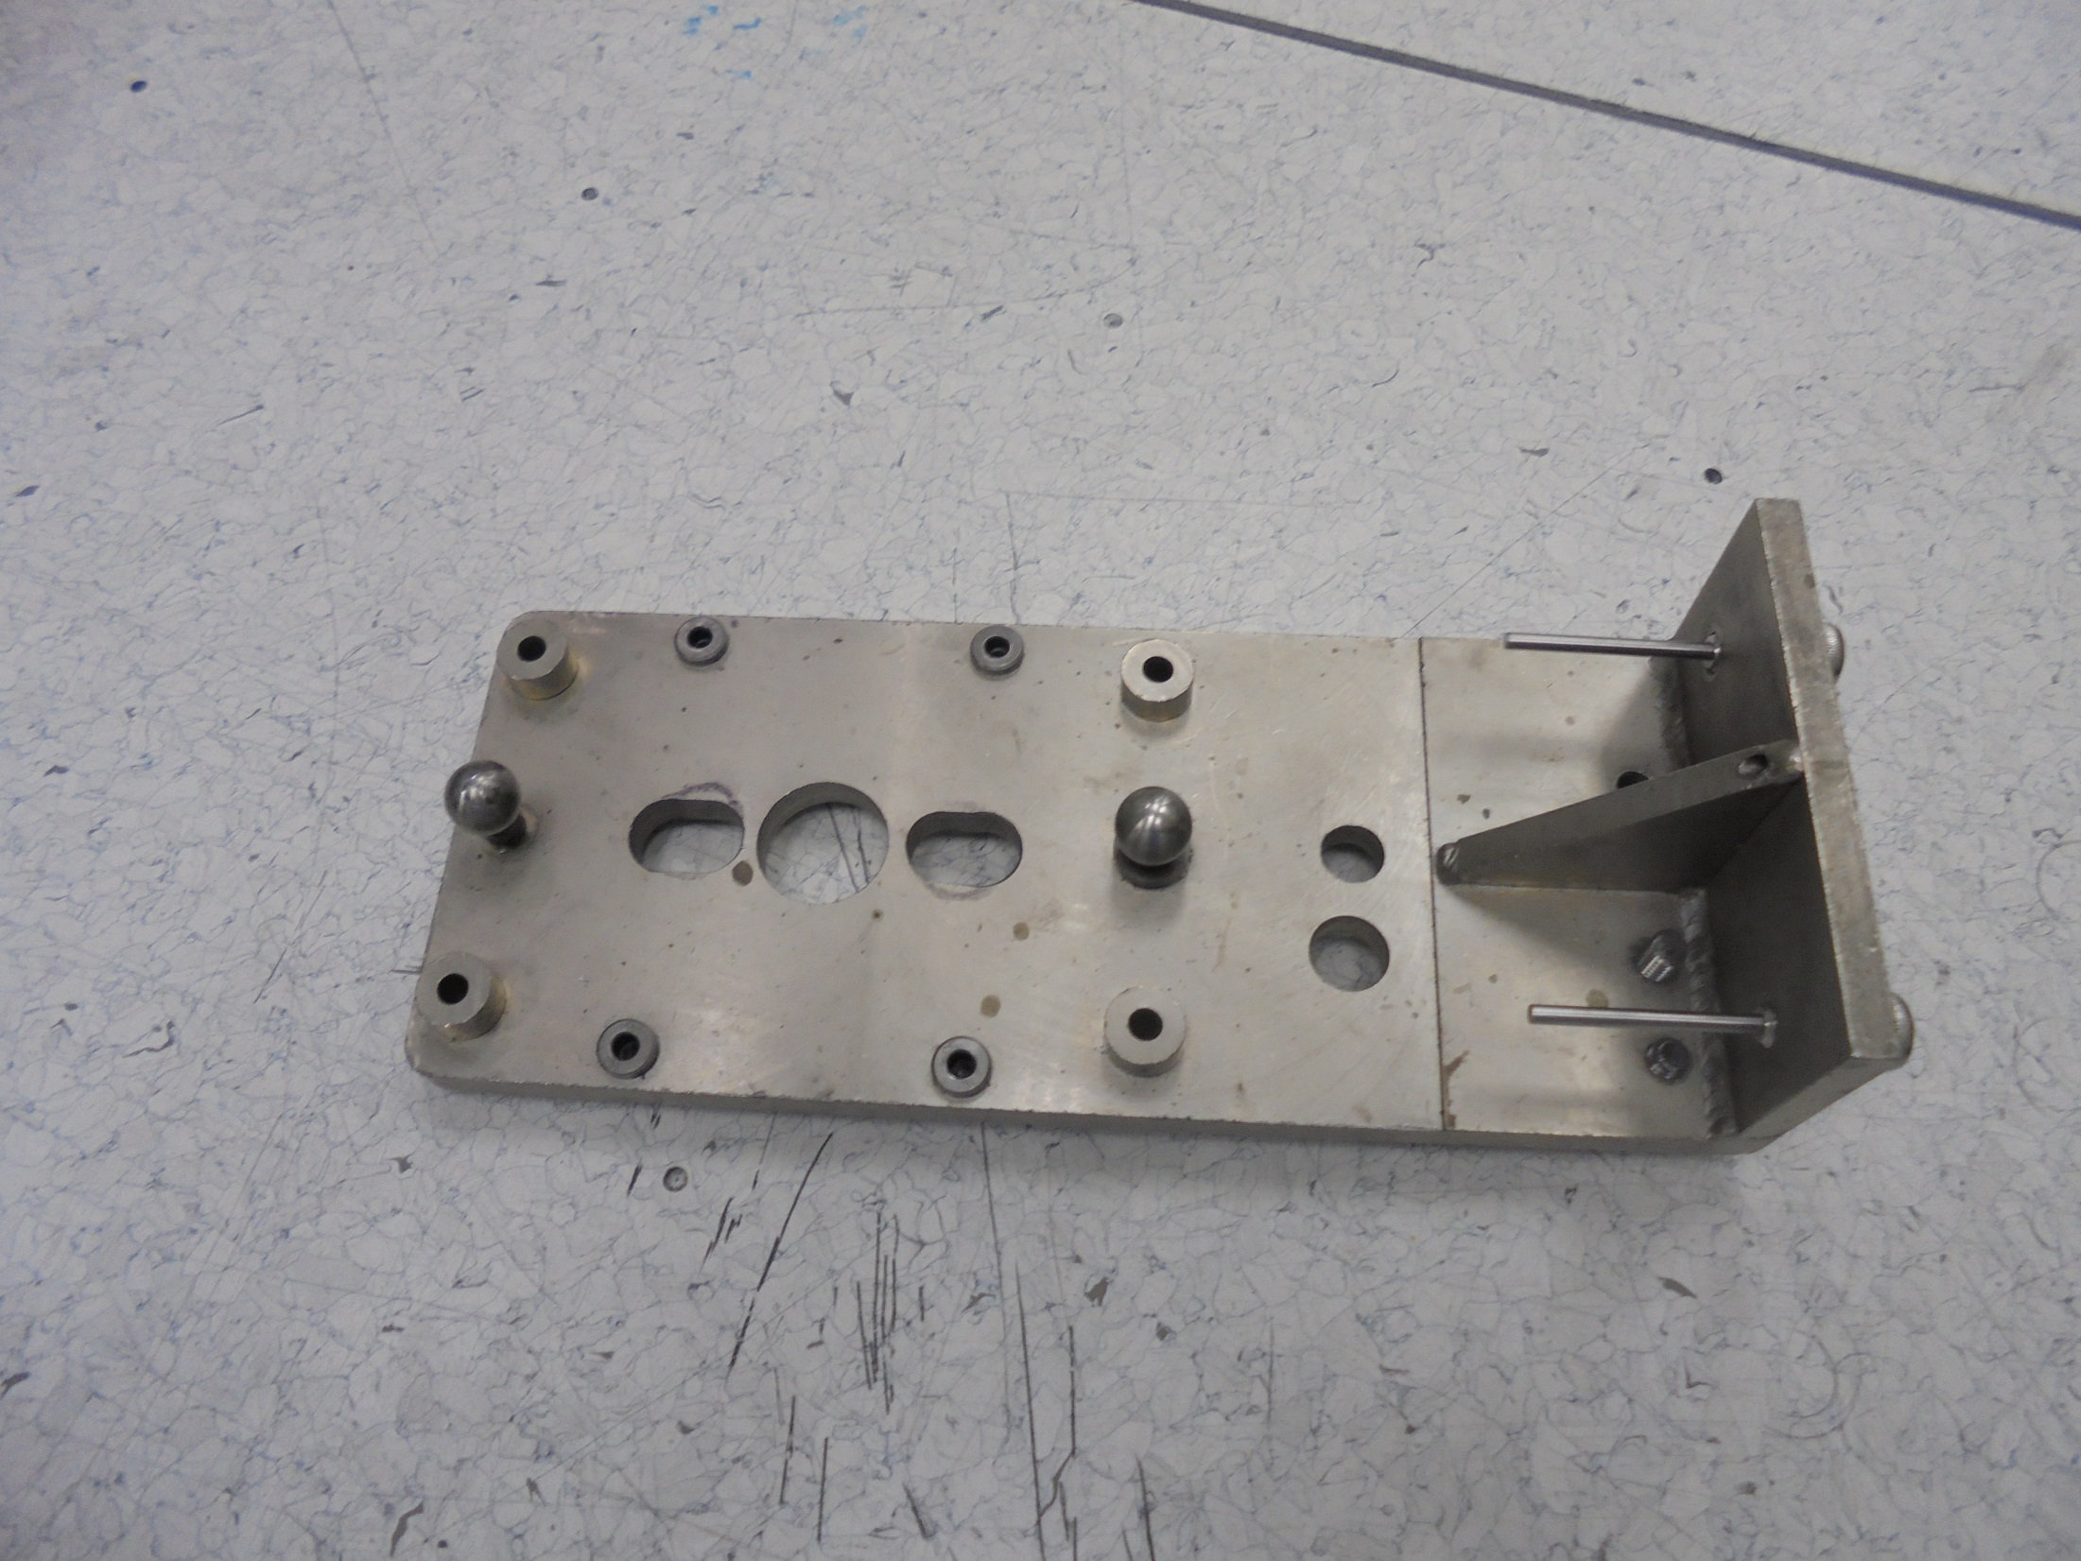
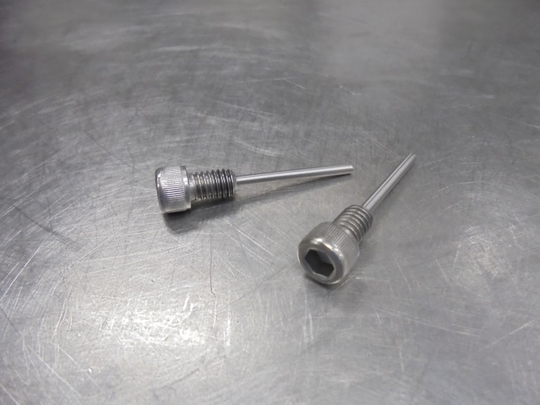
Alignment Pins
CALIBRATION Alignment Jig

Slide 33
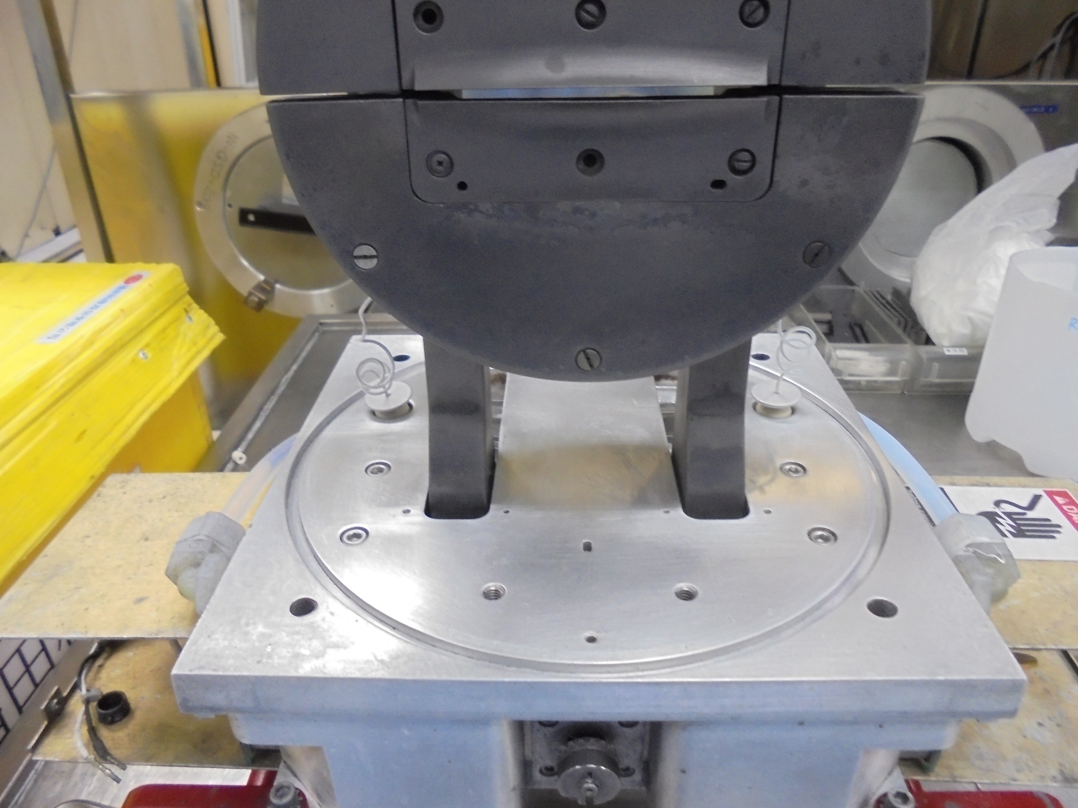
Slot for CALIBRATION Jig

Slide 34
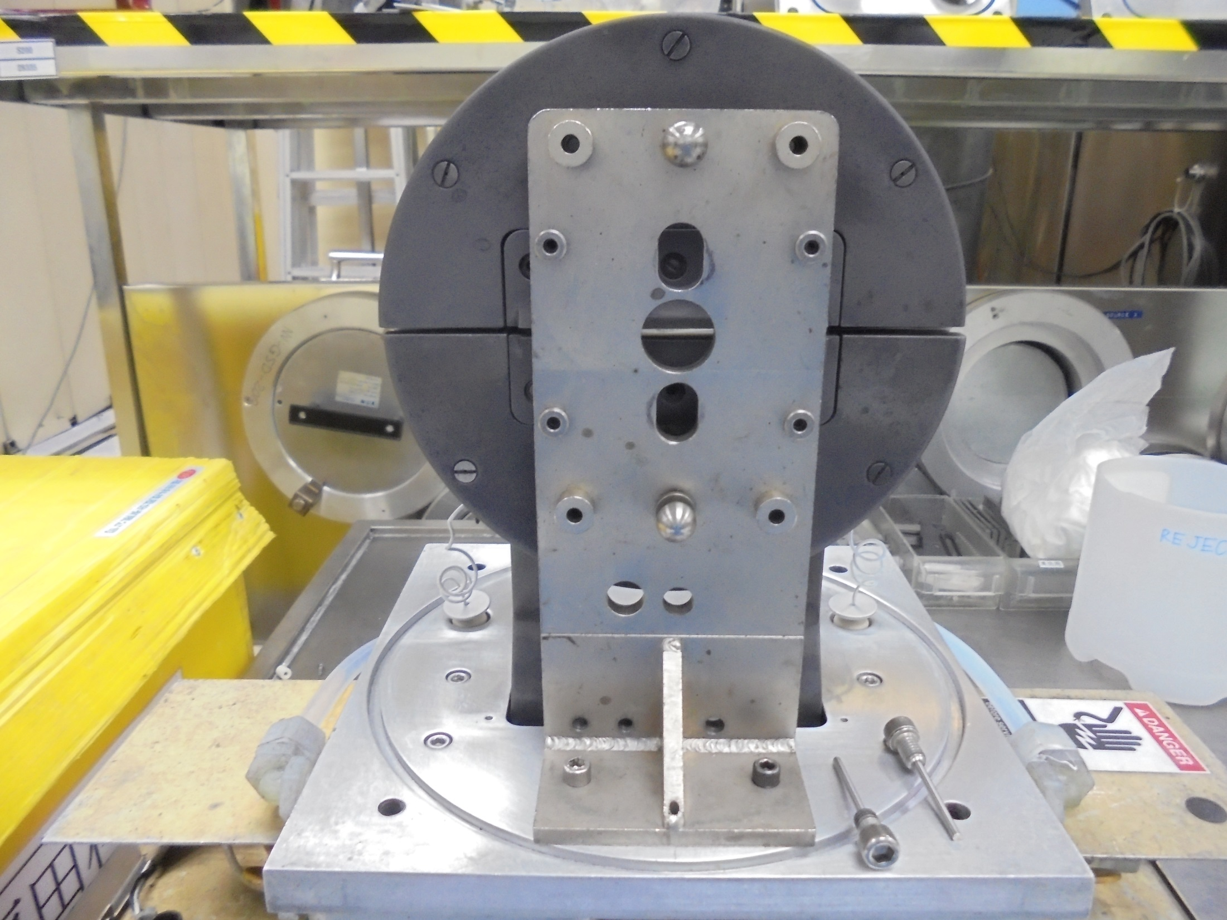
Secure the Screws

Slide 35
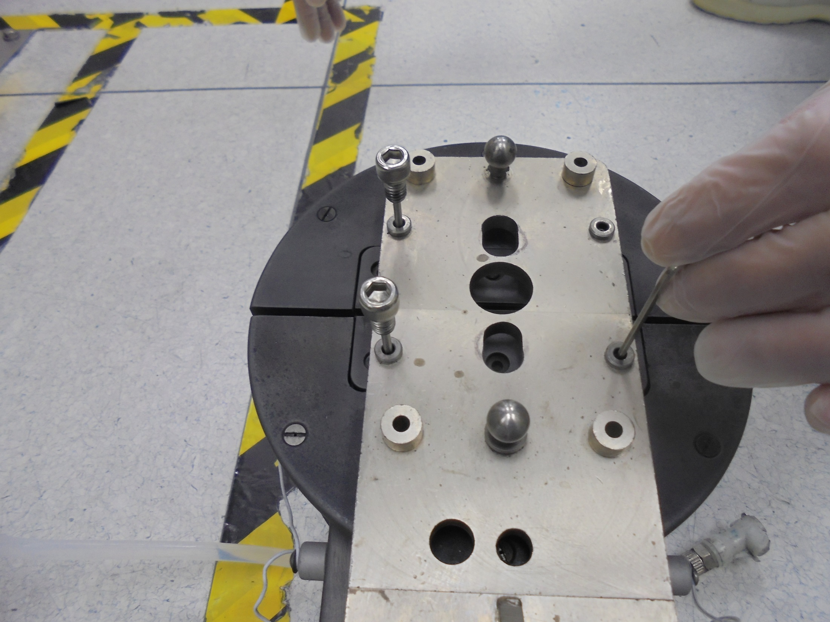
*Conduct Alignment Procedure
Alignment Pins
Hex Key Tool

Slide 36
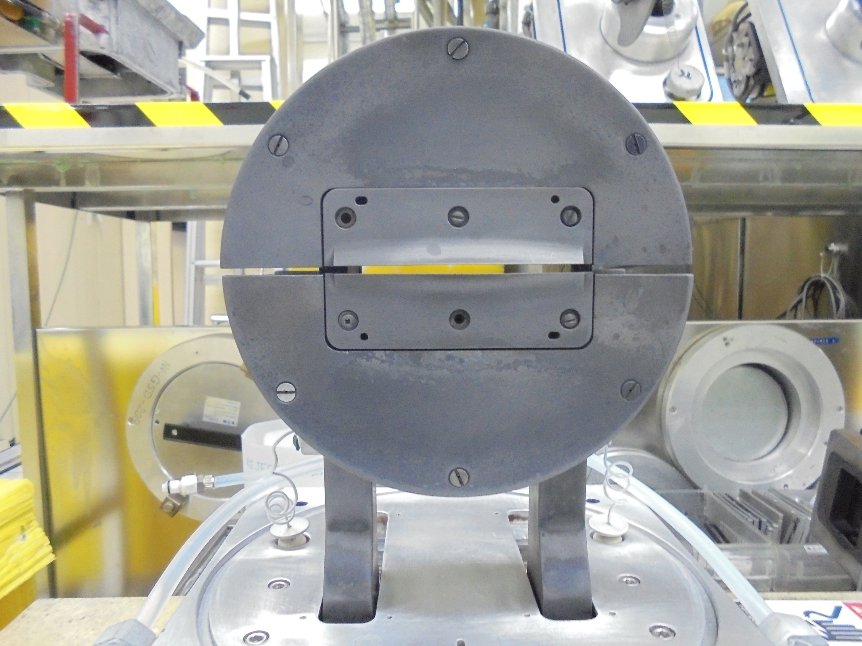
Clean the O-RING Slot

Slide 37
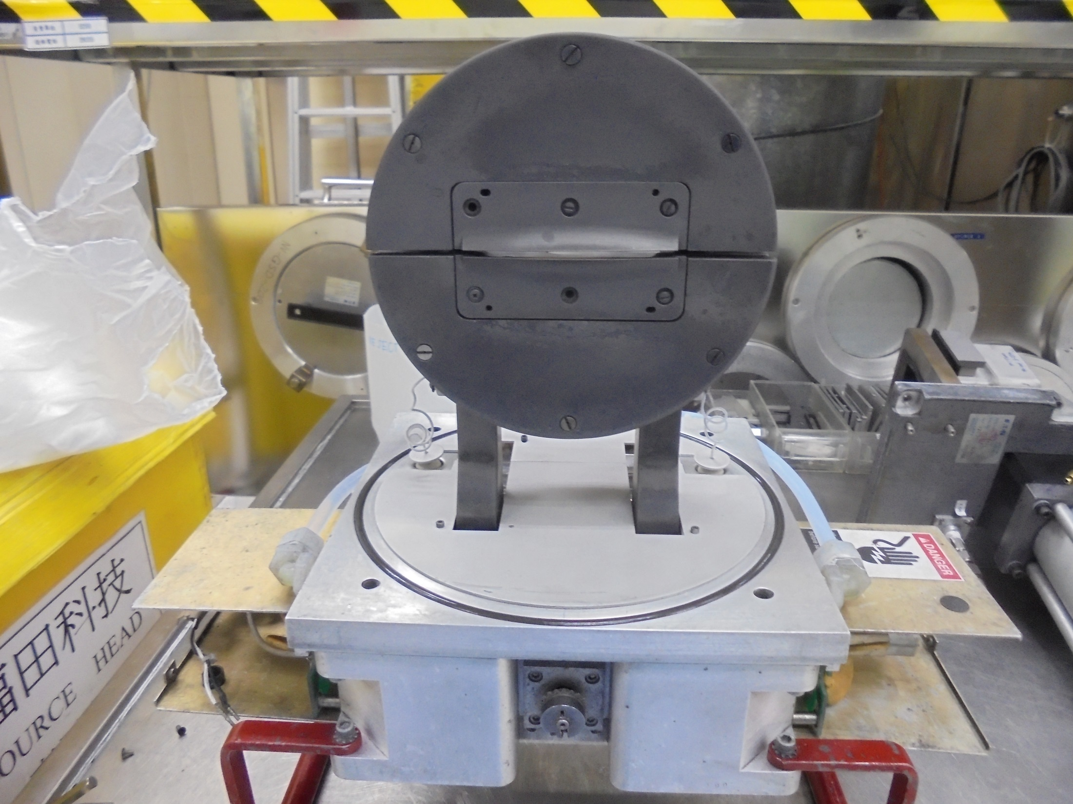
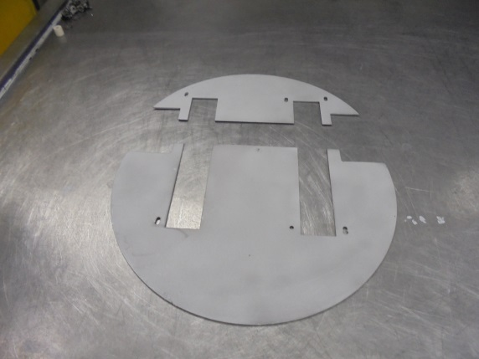

Re-Install Cover
O-RING

Slide 38
High Voltage Test

Slide 39

TEST METER

Slide 40

UPPER
BODY [Ground]
Test Past

Slide 41

LOWER
BODY [Ground]
Test Past

Slide 42

Test SUPPRESSION Supply 1 and 2
Test Past
Maintenance Done.

Slide 43
-END-

